Slide 1




Setting the Spiral2 control system for the on-going commissioning
Notes:
So, good morning. You already got some news from Françoise previously, I am going to go a little bit deeper into the Spiral2 control system for the commissioning which should start quite recently from now.
First of all, the Spiral2 control system results from the collaboration between three labs so you heard about Irfu CEA Saclay. Others are IPHC Strasbourg, and Ganil which is the installation site.

Slide 2
Outline
Introduction
  The Spiral2 project
  Control system deliverables
  Collaborations for the control system
The Spiral2 control system
  Infrastructure
  Equipment configuration
  Sources and beam lines controls
  From RFQ to HEBT
  GUIs environment
  Software integration
And now ?
Notes:
The talk outline will be the following :
As an introduction, I will briefly remind you the objective of the Spiral2 project and its current status.
Then, I’ll give some figures for the deliverables to be provided and present the work packages as defined by the organisation for the collaborations.
Therefore, I’ll present a global overview of the control system as it is now , with first some focus on the equipment configuration. Then we well go along the machine itself with in a first phase the sources and beam lines controls, followed by the acceleration part.
I ‘l also put then some emphasis on specific items such as the GUIs tools we are using and the work in progress for the software integration.
Lastly, as a conclusion, I’ll try to give some perspectives concerning the control system according to the project milestones.

Slide 3
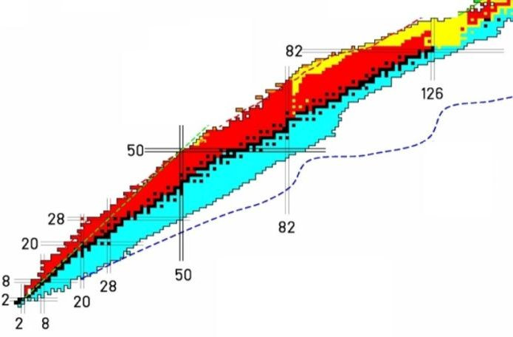
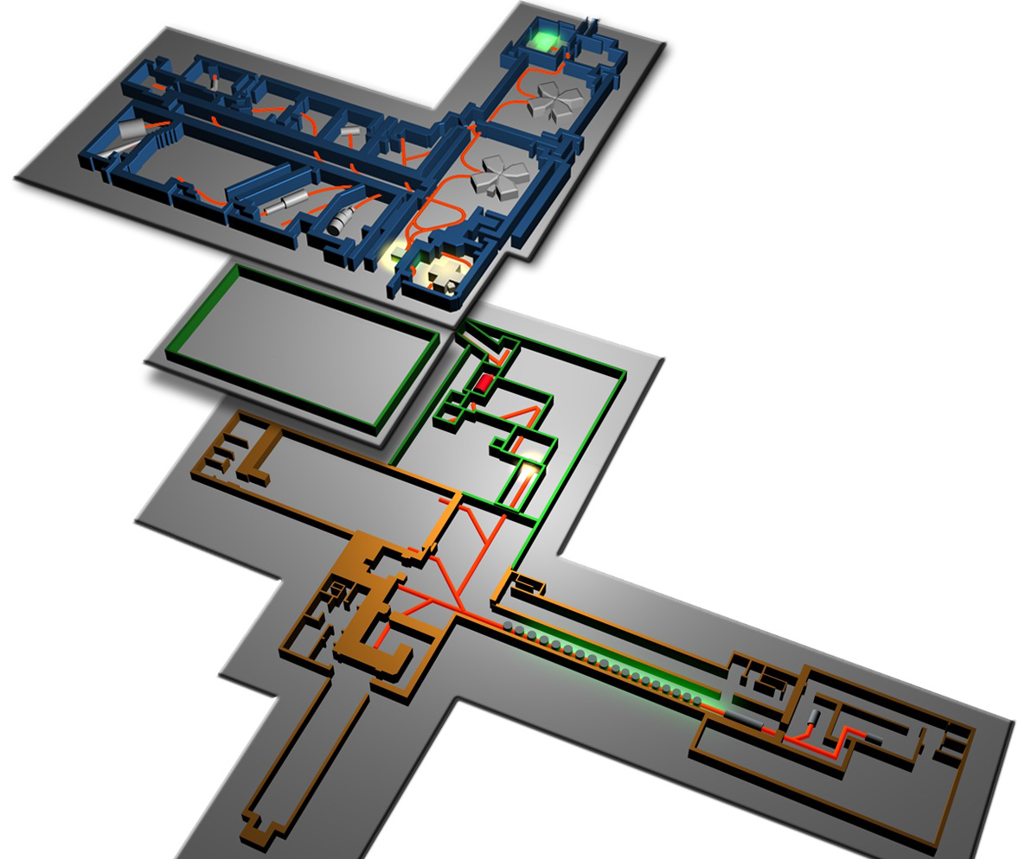

Spiral2 : a new Rare Ion Beam facility
Z
N
DESIR experiment room
S3 experiment room
beam production & acceleration
NFS experiment room
Notes:
So, now, let me introduce briefly the Spiral2 project.
The Spiral2 facility will be a new Rare Ion Beam facility for nuclear physics and astrophysics.
It will be install next to the existing Ganil facility. Ganil has been already for yeaers producing exotic nuclei as shown on the chart of nuclides.
Spiral2 will extend this area and will allow improve the quality of beams to be delivered.
The first phase of the project is the acceleration process for deuterons, protons or heavy ions, with specific experimental rooms attached. The first to be started are the NFS room for neutron science and the S3 spectrometer ;
A little bit later will be delivered the DESIR area integrating a high resolution spectrometer being able to receive both beams coming from Ganil or Spiral2.

Slide 4
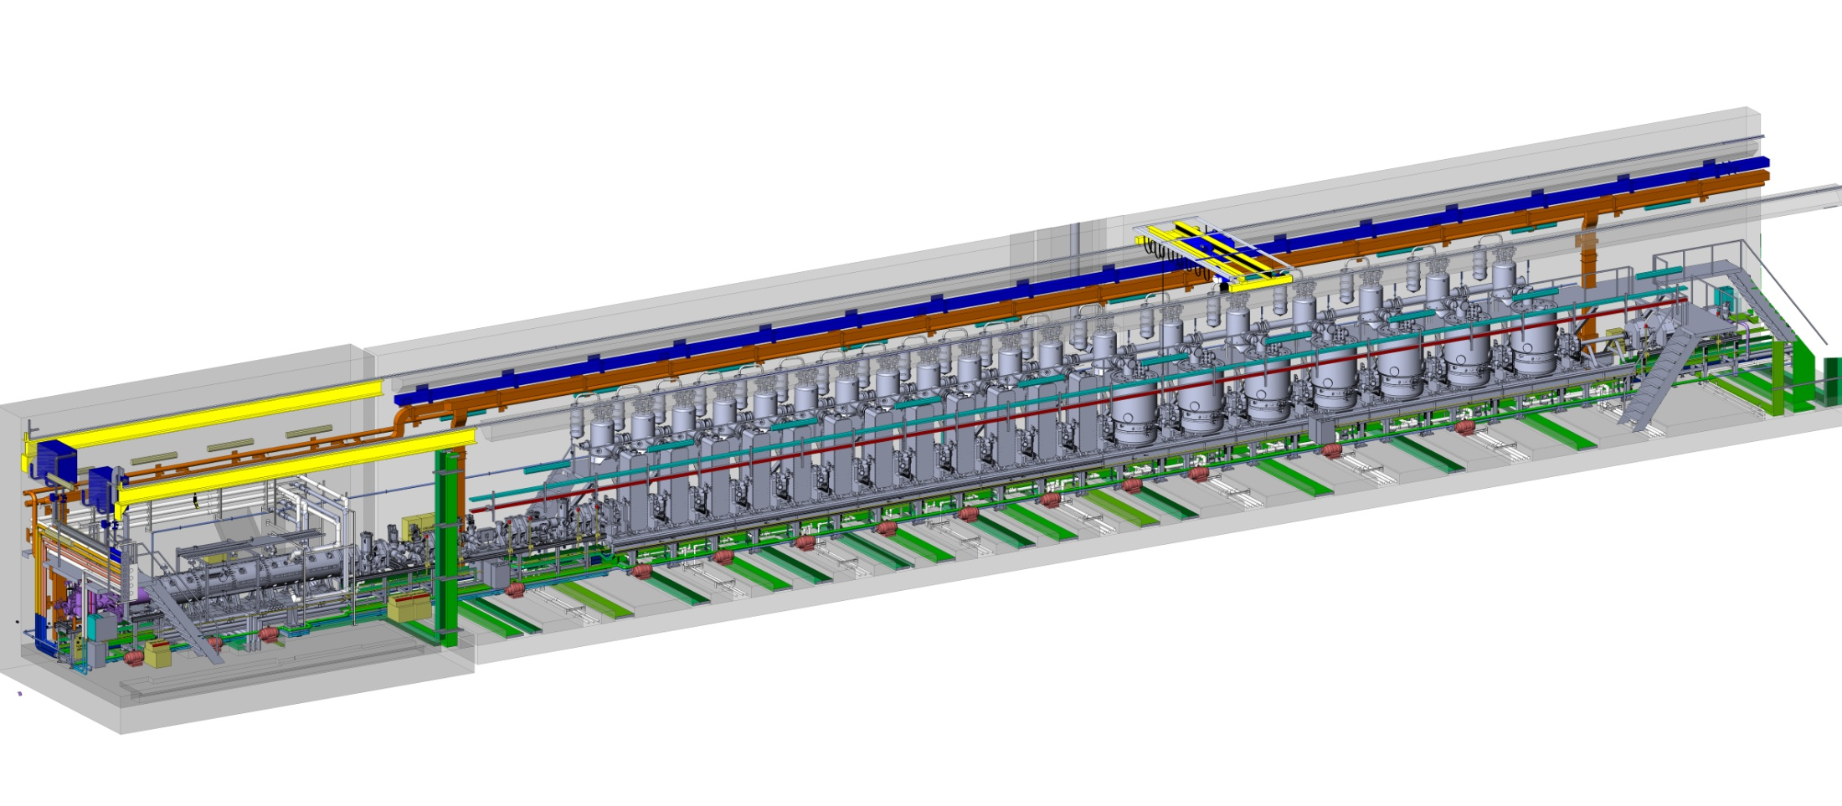
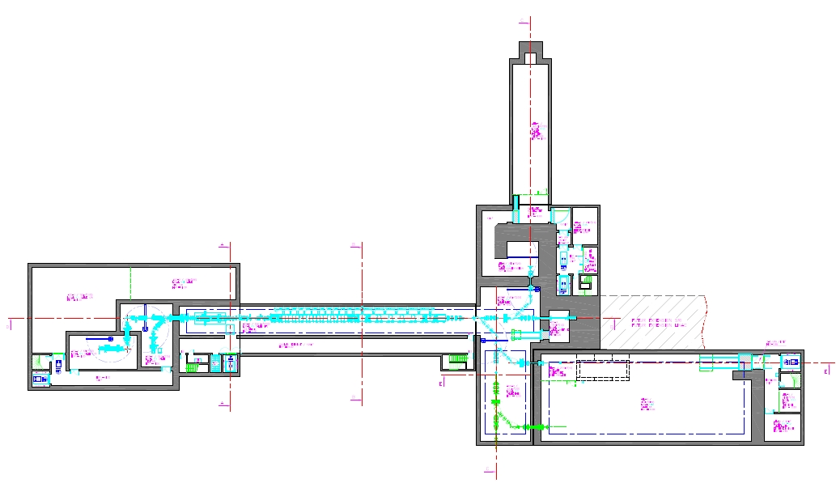
Spiral2 : accelerator design
Beam characteristics
 | Q/A | I (mA) | Energy (Mev/u) | CW max beam power (KW)
Protons | 1/1 | 5 | 2 - 33 | 165
Deuterons | 1/2 | 5 | 2 - 20 | 200
Ions | 1/3 | 1 | 2 - 14.5 | 45
Ions (option) | 1/6 | 1 | 2 - 8 | 48
NFS
RFQ
Linac
S3
>1/3
>1/2
To RIB production
To DESIR room
Notes:
Now, let us see quiclky the accelerator design mainly relying on a Linac.
Beam characteristics at the output are summerized on the table on the right. Particles will be either heavy ions with a charge over mass ratio of 1/3 or deuterons.
Pre acceleration will be given by a RFQ and the Linac consists of two series of cryogenic modules equipped with one or two RF cavities.
To save time, the sources and low energy beam lines were installed and tested for a couple of years at Saclay and Grenoble to get a first beam production and partial commissioning before the on-site installation.

Slide 5
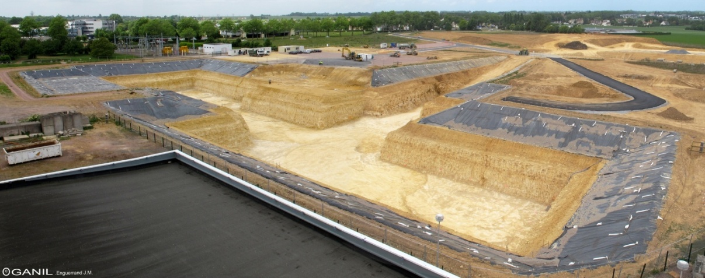
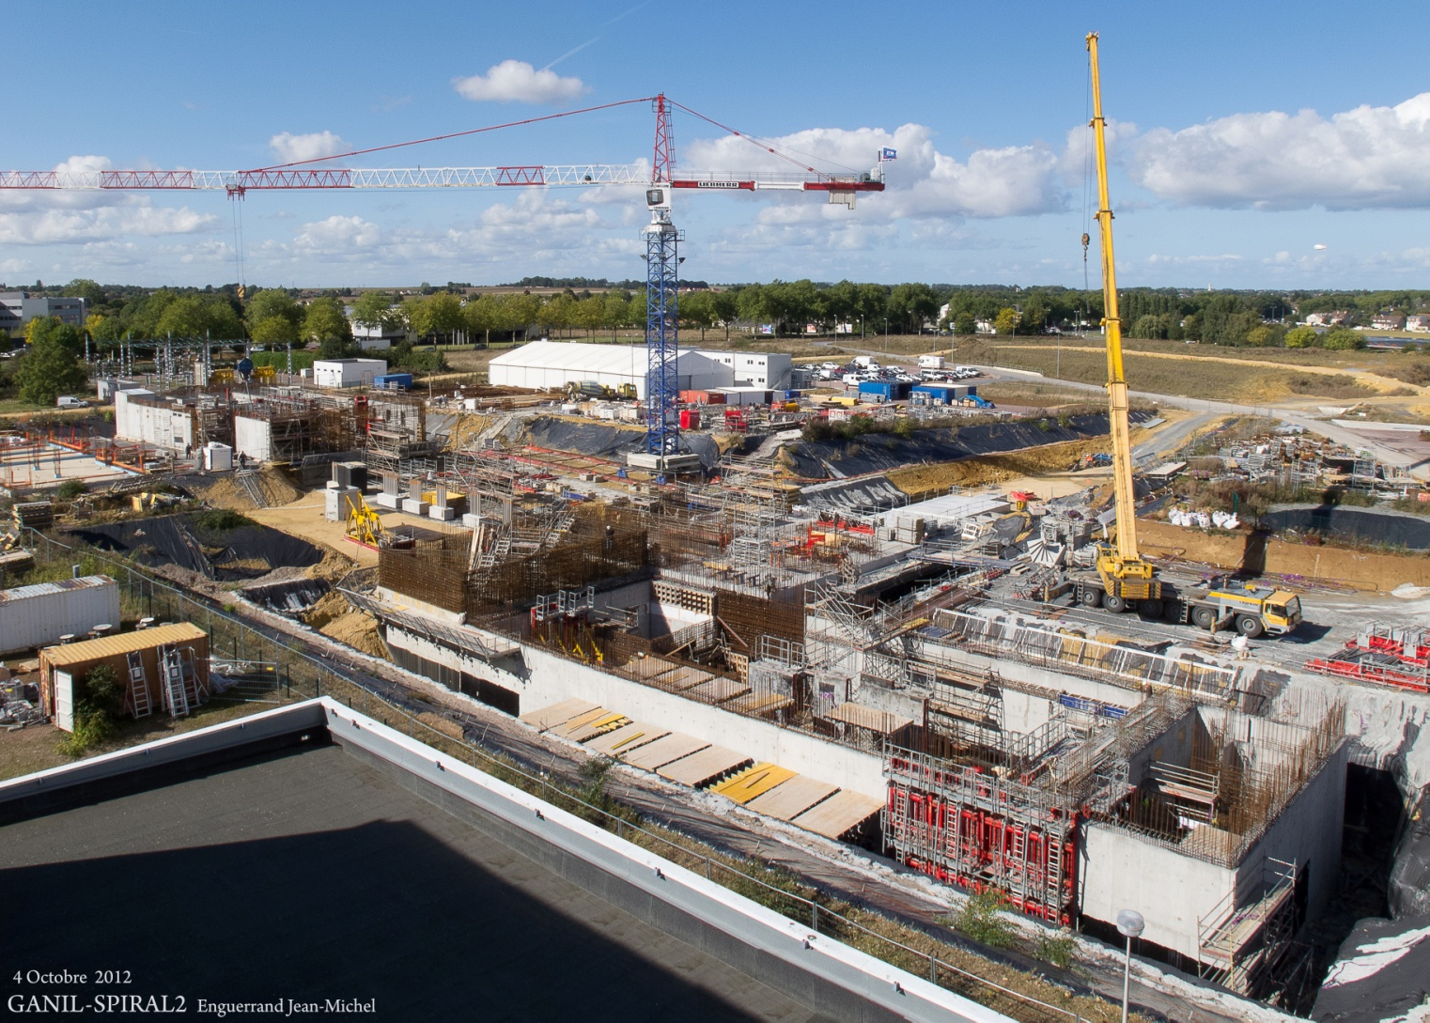
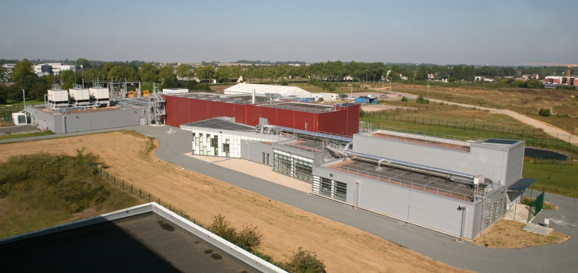
Spiral2 : building constructions …
May 2011
October 2012
October 2014
Notes:
Quiclky now, let’s have a look to the ground level.
Works started in 2011 and went on for the following years so the building construction is now completed.
One important thing to notice is that the accelerator itself will be underground at minus 9 meters.

Slide 6
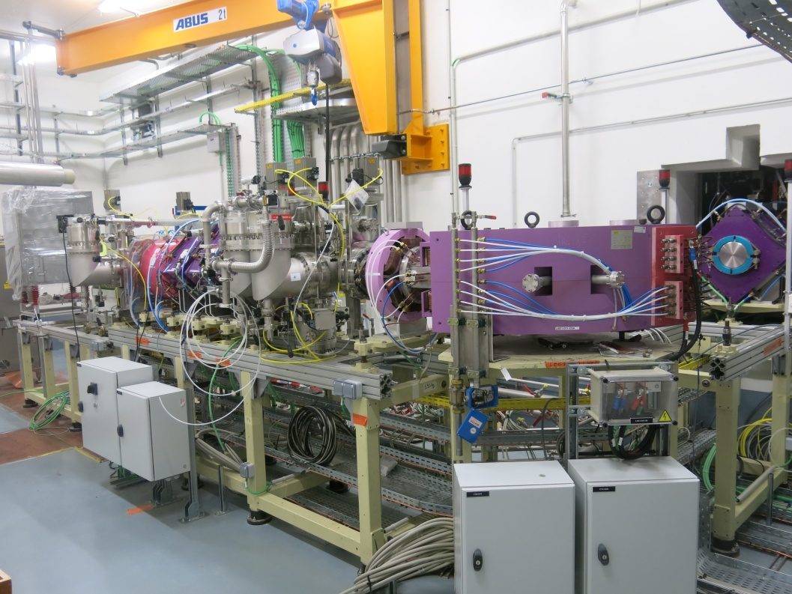
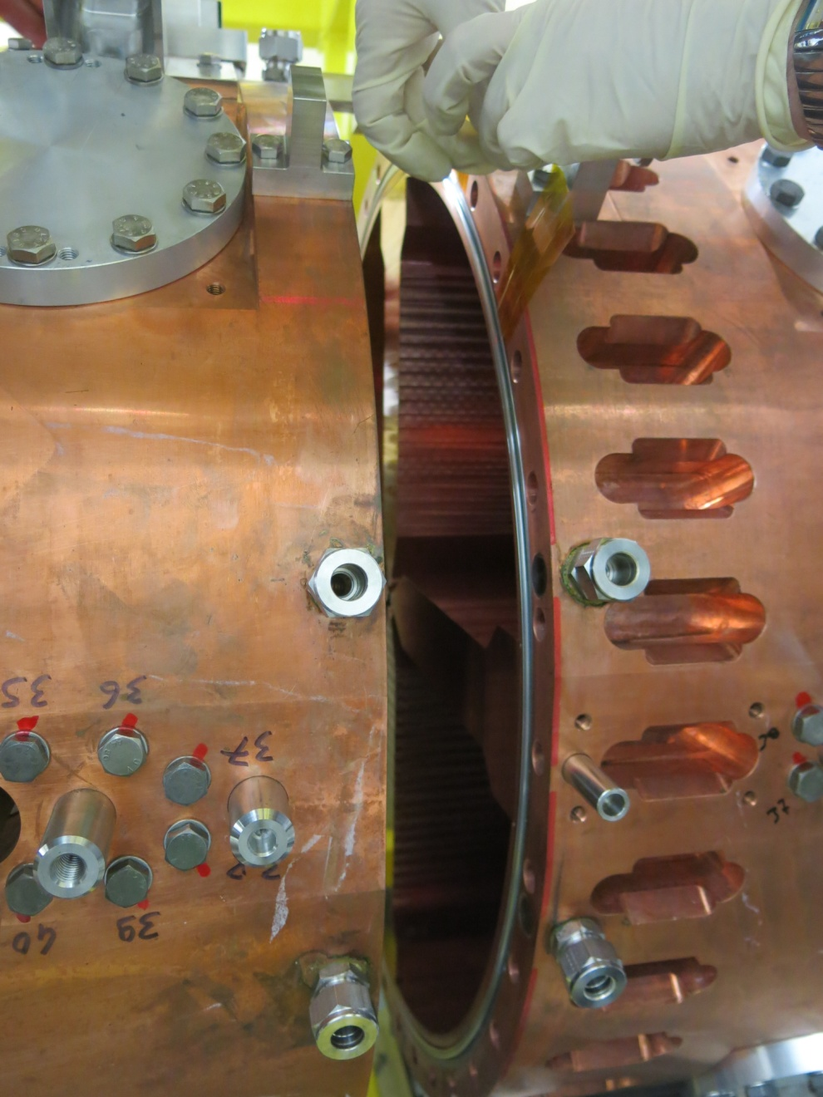
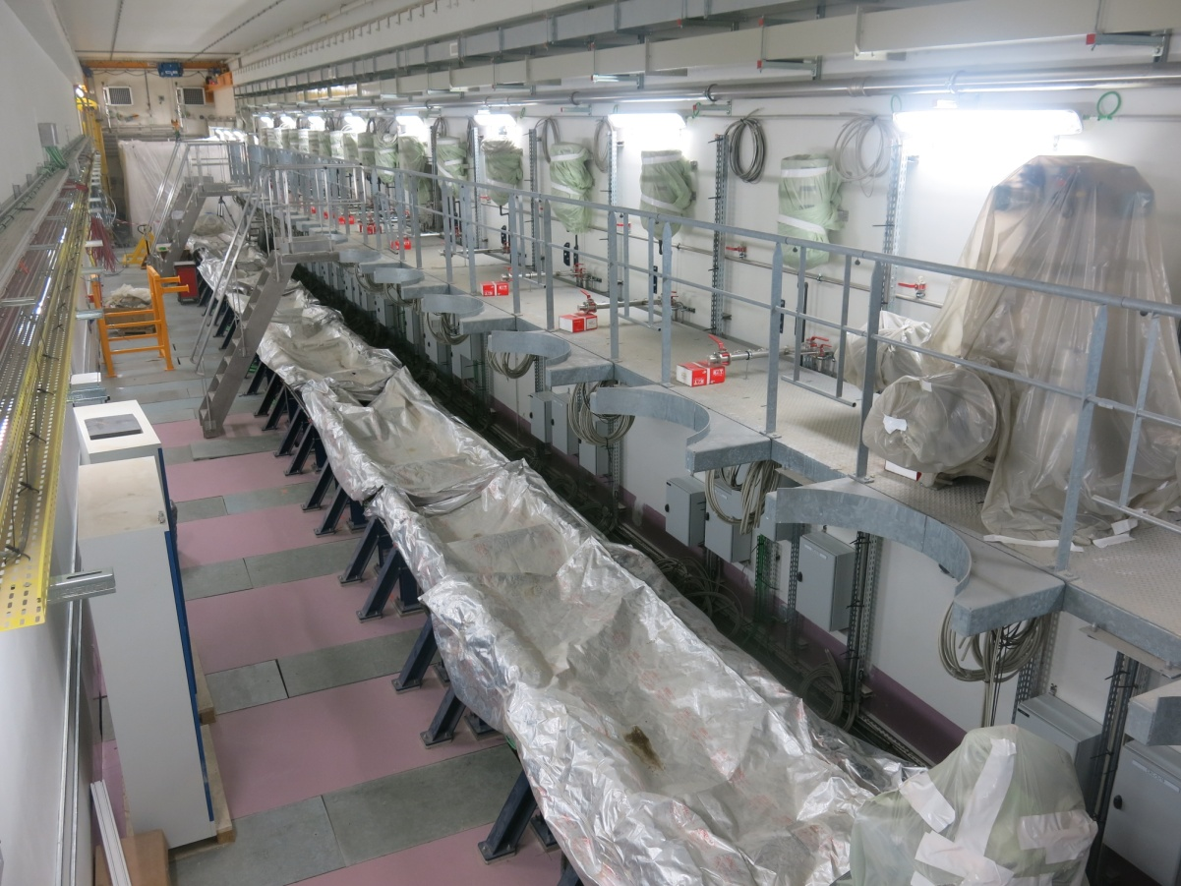
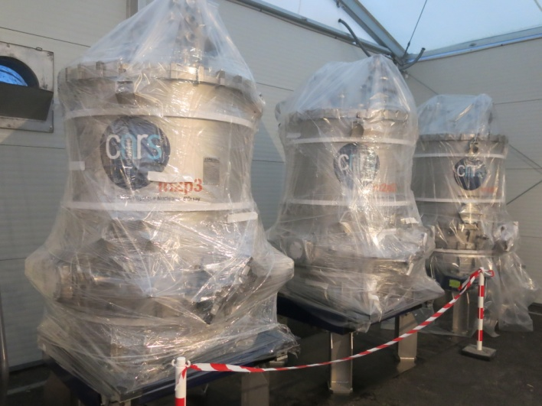
Spiral2 : ... along with the process installation
RFQ
LEBT1
Linac tunnel
Cryomodules waiting for installation
Notes:
As soon as it was possible, in parallel to the bulidings construction, the installation process started.
So, presently, the ions and deuterons sources are installed with the associated beam lines.
The RFQ has just been mounted in last September and cryogenics plant and distribution is under installation.
The mechanical frame for the Linac is now ready and some of the cryomodules are now waiting in the stockage area for being moved down and installed into the tunnel.

Slide 7
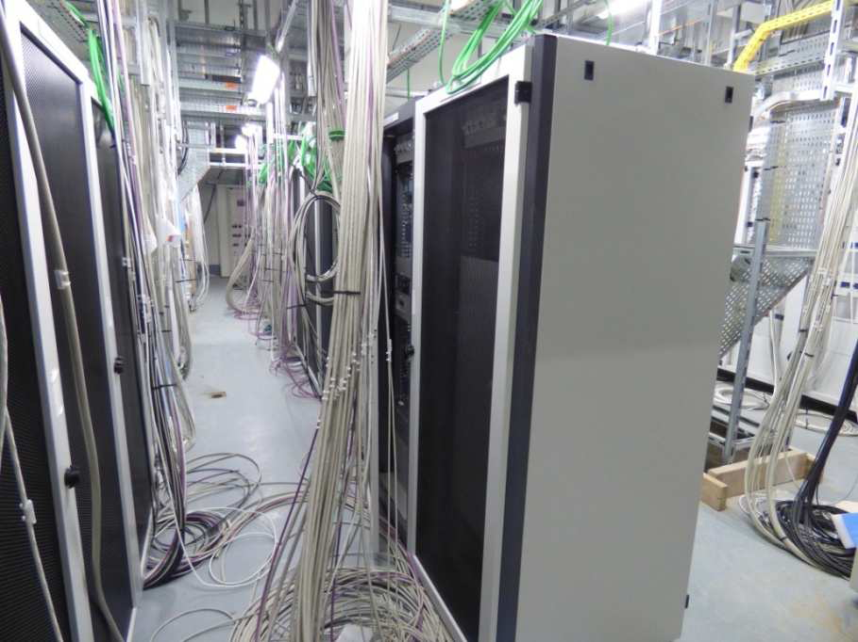
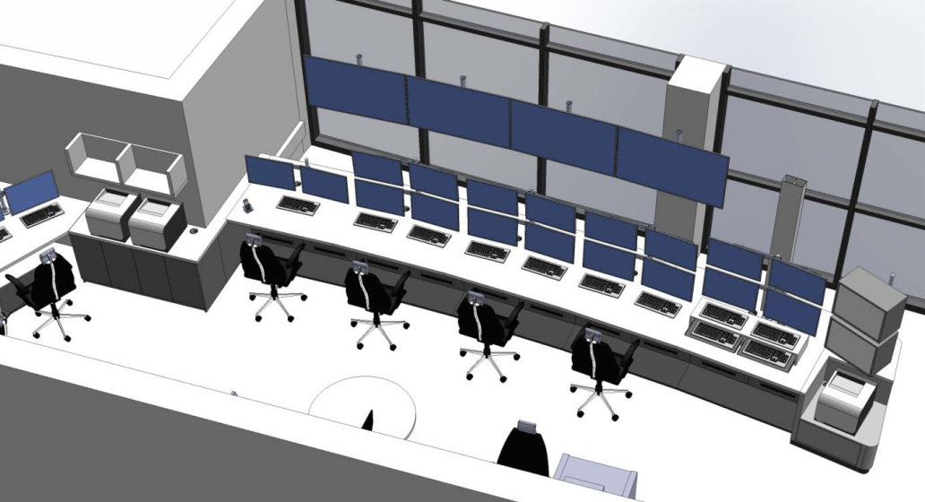
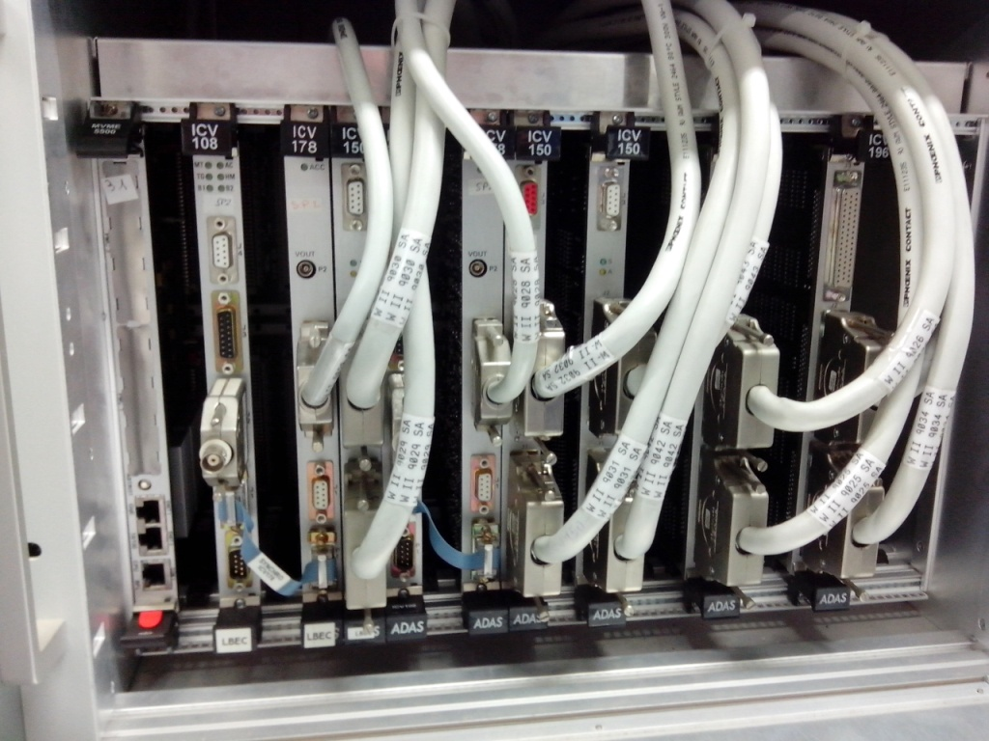
Spiral2 : and what about the control system ?
Work project for the PCD control room
Racks installation & cabling
VME chassis installed waiting for the electrical switch-on and checks
Notes:
So now, it’s time to move to the control system topic.
Here is the Spiral2 control room and its future implementation as seen by interior designers.
This control room will be used during the commissioning and test phases. The new facility will have to be controlled either from this new one or from the existing Ganil control room.
The racks were installed inside the different technical areas and corridors. Cabling is under way and will have to be checked and validated.
The VME chassis are installed. They are now waiting for the electrical approbation to be switched on, then people will be able to perform the last hardware and wiring checks before running the software.

Slide 8
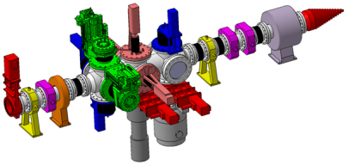

Control system : ~70 man.years of collaboration
(~8,5 FTW)
HEBT
BTI
Global coordination
Equipment interfaces :
 Power supplies
 Profilers, BLMs, BPMs
RF
Central services
High level applications
Databases
CSS distribution
SVN server
Injector controls
 Ion source control
 Deuteron source control
Epics distribution & repository
Equipment interfaces :
 CFs, slits, ACCTs-DCCTs
 TOF, FCT, CFR
LLRF
Equipment interfaces :
Emittancemeters
BEMs
BTI
Notes:
A few words now concerning the organization for the collaboration which is estimated to 70 man.years up to now.
As you know, the collaboration for the Spiral2 control system implies three labs.
Françoise already told you about the Irfu role inside the collaboration.
IPHC Strasbourg first developped the emittancemer control system, then is in charge of providing the so-called BTI bench platform sofware layer. This lab quite recently took the responsability of the Beam Extension Monitors.
Lastly, Ganil is in charge of the global coordination. Technically, it had to interface some equipment. According to its position, Ganil also provides all the central services. Because of its experience and skills, it is also in charge of all the high level applications required for tuning the machine, in relation with different databases.

Slide 9
Control system : deliverables
  35 Synoptics
  30 Tuning applications
  10 Services
GUIs
Epics tools
GUIs
Java/Xal
Central services
Channel Access
  20 IOCs
  10 Drivers
IOC : VME
(VxWorks)
I/O
IOC : Linux
Modbus/TCP
Power
supplies
PLCs
RF amplifiers
Profilers
  ~1500 equipment
Notes:
As you know, the SPiral2 control system is Epics based,
Here is the Spiral2 implementation.
Equipment are either reached using the Modbus/TCP protocol or through direct VME I/0 boards. IOCs to handle them are Linux PCs or VME crates running VxWorks.
On the top level, GUIs are implemented using standard Epics tools or specific programmation ; Java has been adopted at Spiral2 also relying on the Xal framework.
Some figures now for the control system to be provided. The global deliverables are estimated to :
35 synoptics
30 tuning applications
10 central services
20 IOCs associated to 10 drivers
30 device type interfaces for 1500 pieces of equipment.

Slide 10
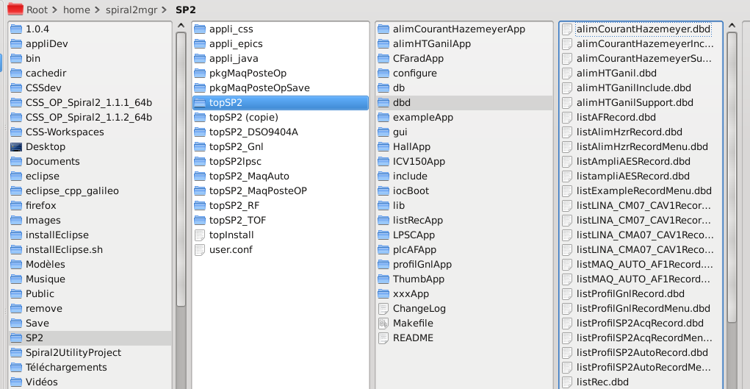
Control system : shared platform
Common Spiral2 development platform (“topSp2”):
  Provided and maintained by Irfu
  Shared by the three labs
  Spiral2 version of the EPICS environment (development, operation)
Rules and formalization
  Interfaces between IOCs and GUIs
  Files naming
  Repository
  organization
  For on-site
  integration
Development
hosted on a
shared SVN server
@Ganil
Notes:
A first important development was to provide a shared software platform, this is the topSp2 platform as presented by Françoise.

Slide 11
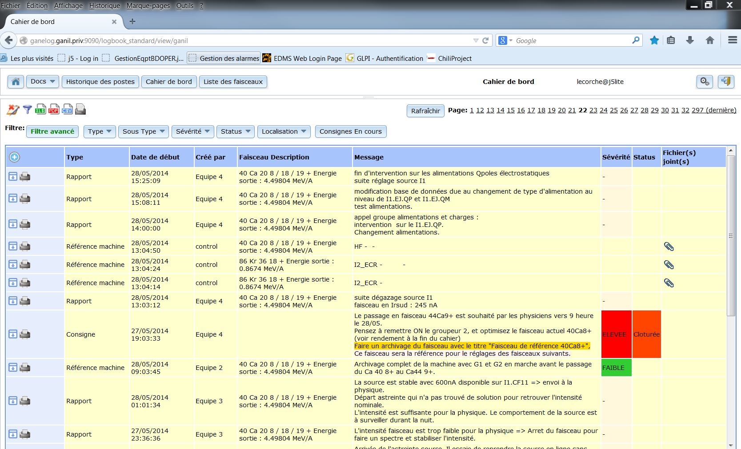
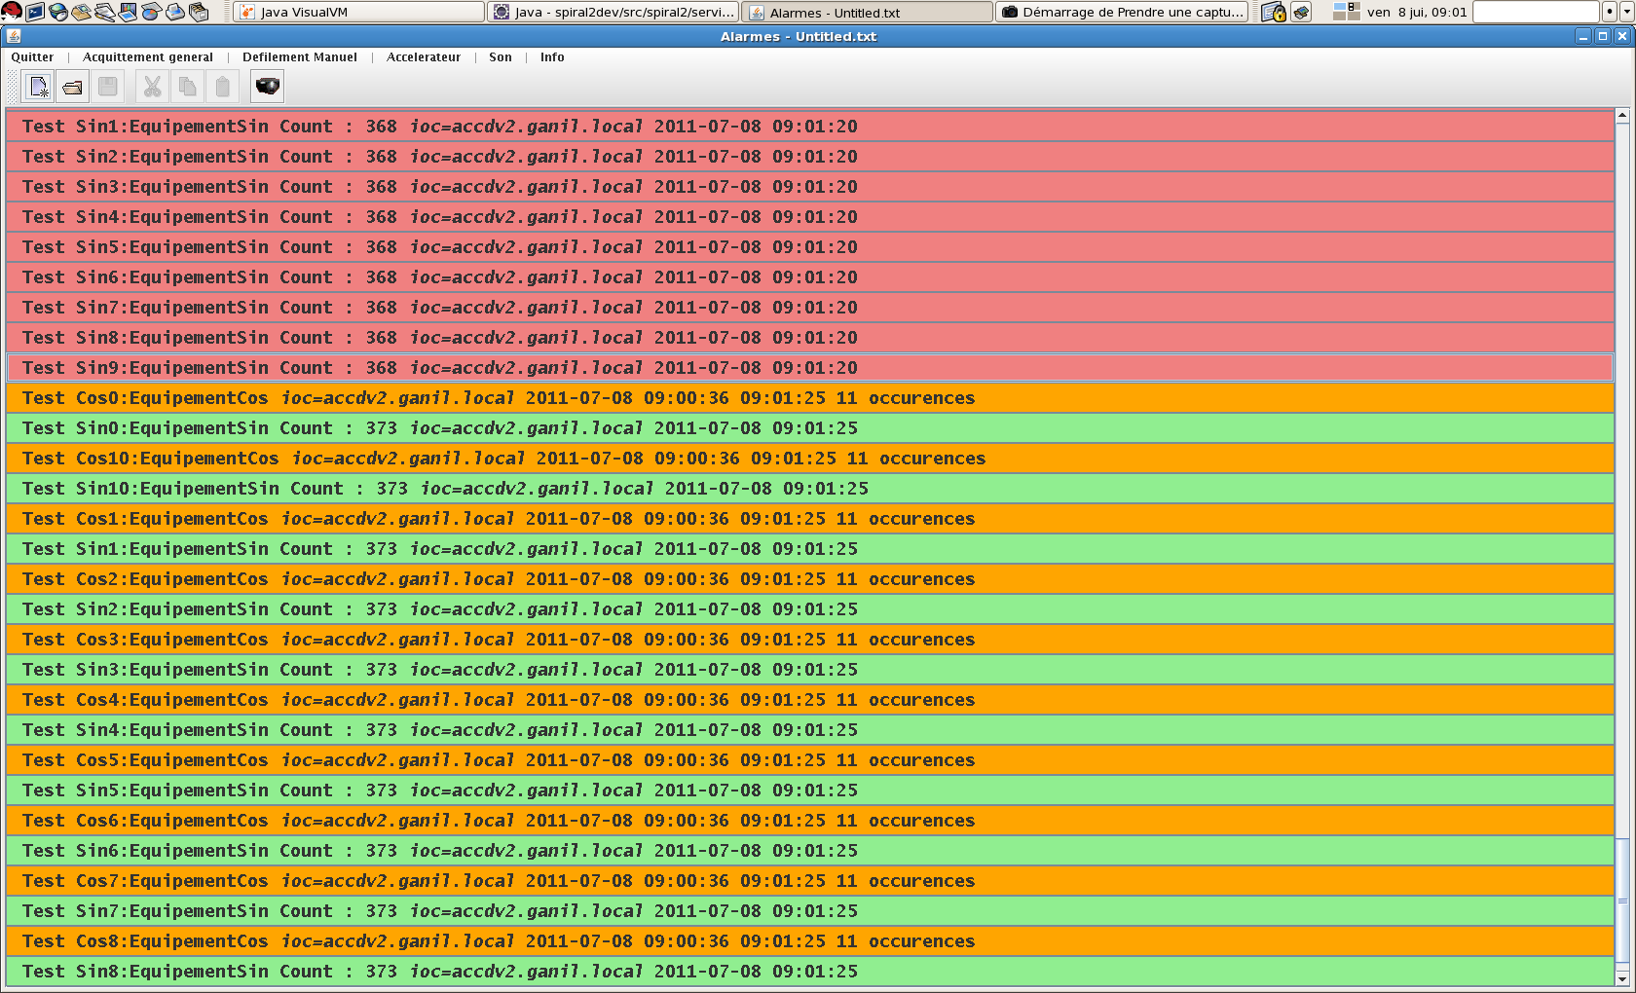
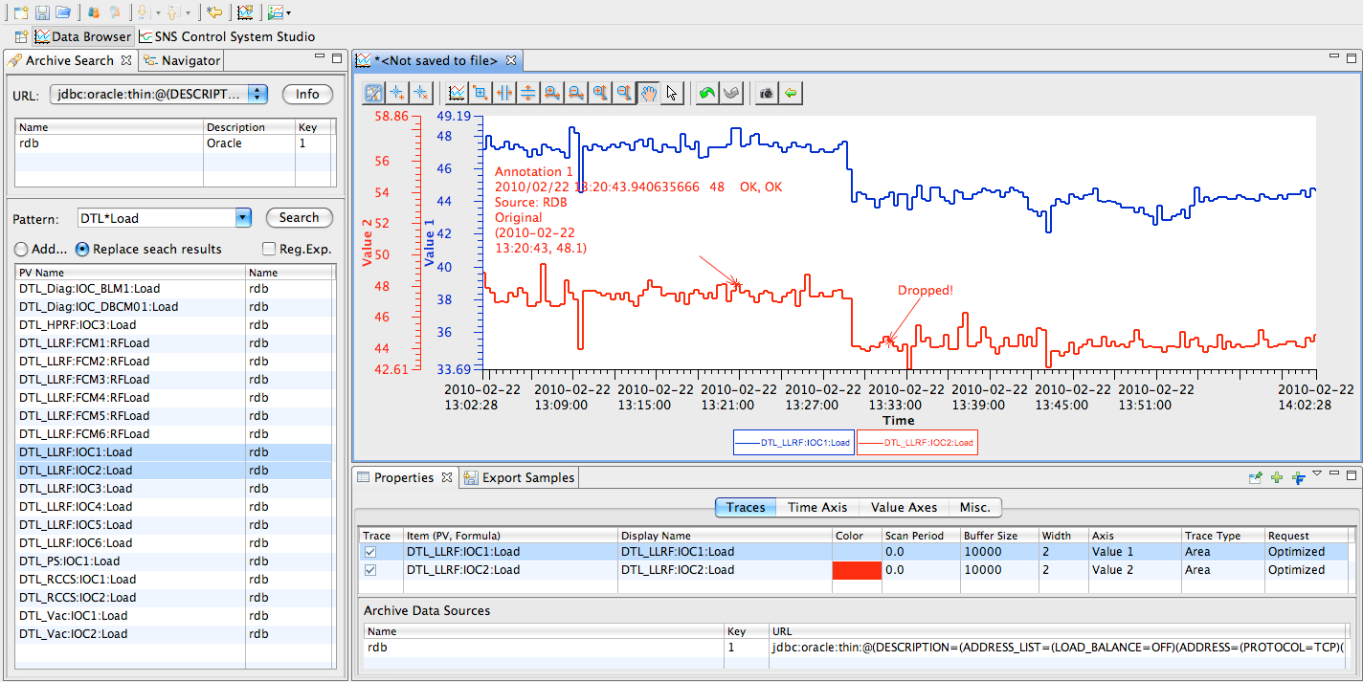
Infrastructure : central services
E-logbook
(commercial j5 product in use at Ganil)
Alarms handling
(in-house development
shared Ganil/Spiral2)
Archiving system
(CSS)
Notes:
Concerning the application software, first we decided to develop our own alarm handling system, not a standard Epics one as we wanted this functionnality to be a shared solution both for Ganil and Spiral2.
For the archiving system, we adopted the CSS standard solution CSS.
Lastly, we proposed to adopt as a e-log-book the commercial solution who was set and tested for the Ganil operation a couple of years ago. May be some adaptations will have to be brought to the Ganil implementation in use today.

Slide 12

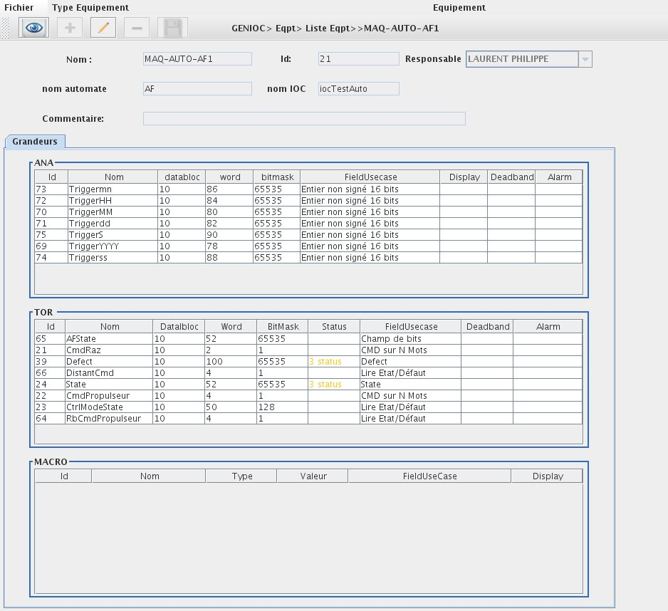


Infrastructure : equipment configuration principles
GenIOC Software
«Device configuration» database
Generates
substitutions
connections
Genioc generation utility
IOC Configuration
Module APP
Genauto generation utility
Module APP « PLC »
Generates module APP
GUI
Developper module using VDCT
Add
Remove
Inhibit
Configure
Equipement
Developper
End user
Notes:
An important issue concerns equipment configuration.
As usual, developpers are using the VDCT tool for configuration, so defining the module App to be provided. Instanciations within the IOCs with the connexions, substitutions et sequencer files have then to be written.
So the Spiral2 control system will provide specific home made tools for generating these files from an equipment database.
These are the so-called genIOC and genAuto software to provide end users the ability to configure themselves their equipment. Data are stored in a the device configuration database wich for us in Ingres. Configuration is achieved using a user friendly GUI, written in Java Swing and accessing the database through Hibernate.

Slide 13
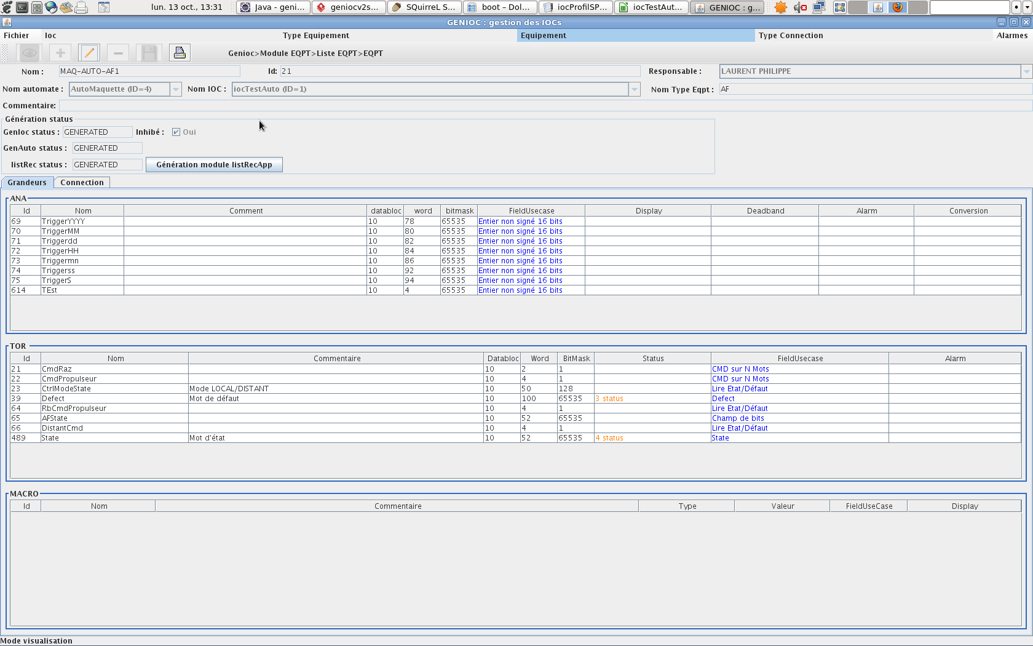
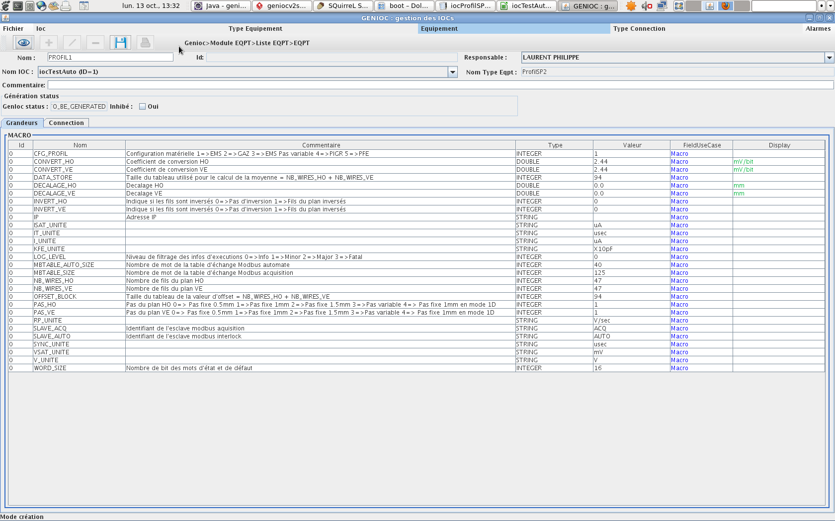
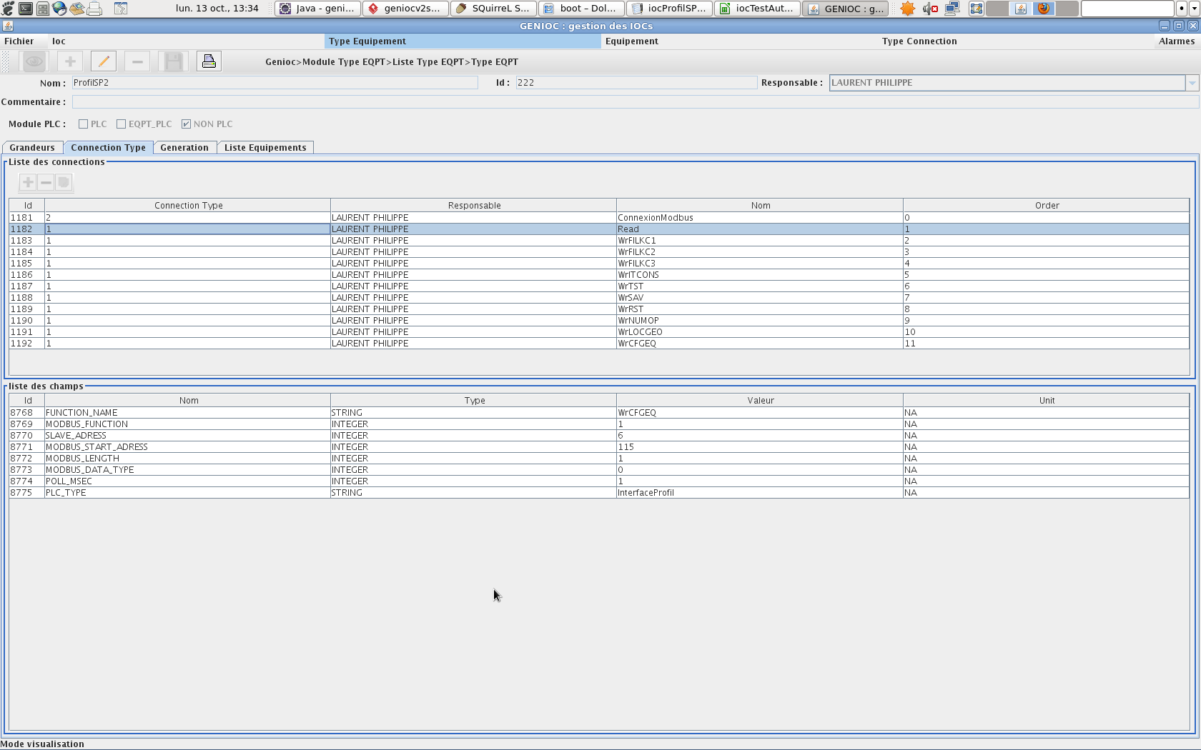
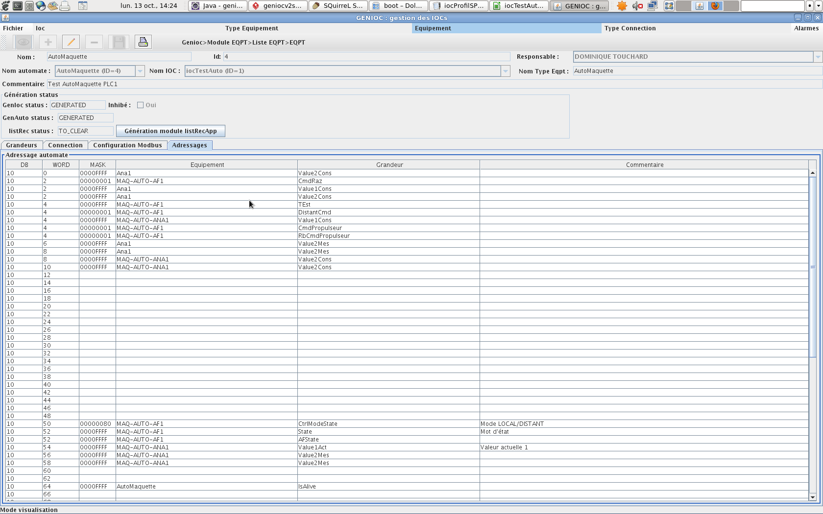
Process
Infrastructure : equipment configuration phases
Standard device configuration
Create
device type « DT2»
Create device « D2» of type « DT2 »
Enter values
for D2
Generate IOC hosting « D2 »
Non Epics fields
 IP, builder …
Connections
 Modbus, VME …
 Value for non Epics fields
Value for connections
PLC device configuration
Create
device type « DT1»
Generate module App for « DT1 »
Create device « D1» of type « DT1 »
Enter values for D1
Generate IOC hosting « D1 »
Epics fields
 State, Defect, Cmd …
Non Epics fields
 IP, builder …
 Displays
Conversion
Monitoring (adel, mdel)
Value for non Epics fields
PLC address …
Notes:
So we considered two main use cases for configuring equipment.
The first step consists of defining by people from the control group the different equipment types abled to be used, here is for example the beam profiler one with its connexion file as the interface is implemented within the Modbus/TCP protocol.
Therefore end users will be able to configure their own equipment. At the end, it is still the control group responsability to generate the IOC files and run the new configuration version.
The second case deals with the PLC based equipment. As it is a more complex environment, the genAuto utility directly generates the specific app modules starting from analog, binary data models
End users are able to manage their own configuration from a GUI as the one presented here. One again, the generation and checking of the configuration is handled by the controls team.
As shown here, it also gives clear interfaces for PLC developers, for example here is the summary of adresses and data blocks used on the PLC side.
We do really think that it will ease the future operation not only on the control side but also for end users as well as for the PLC developers.

Slide 14
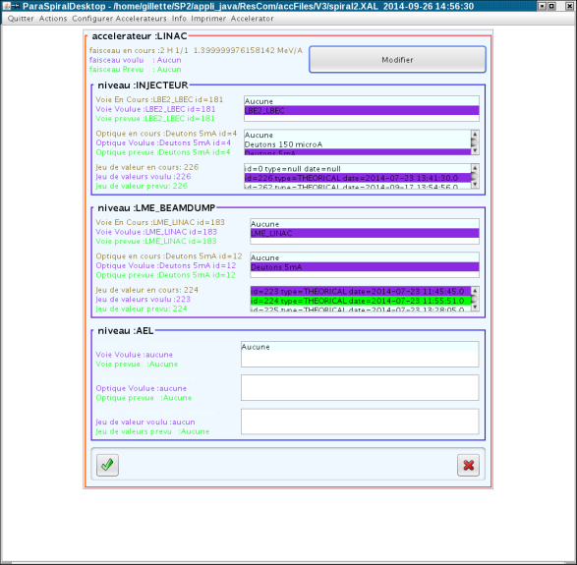
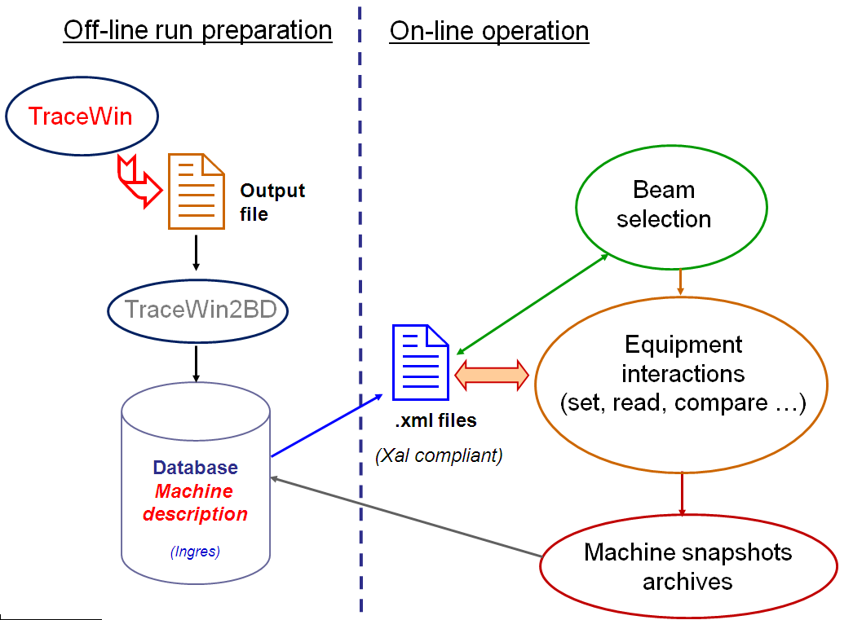
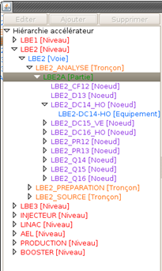
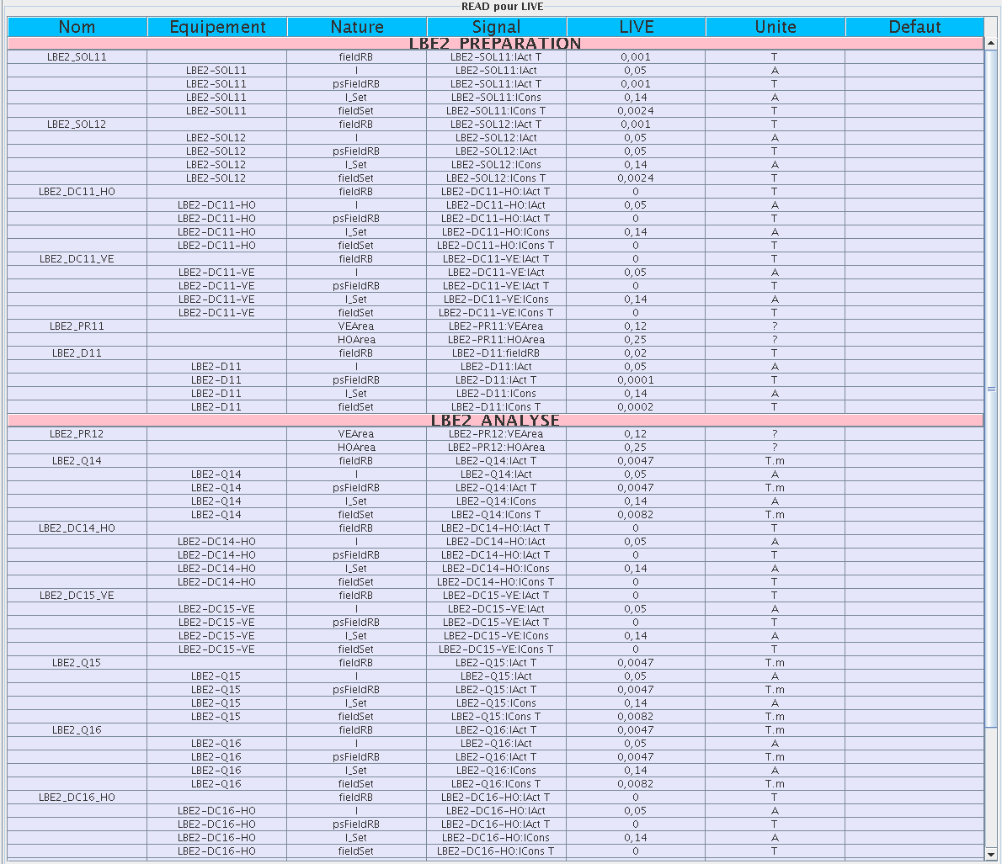
Infrastructure : machine settings management
Accelerator hierarchy description
Lattice machine configuration database
Notes:
We also provide an environment for preparing the setting values for all the machine according to its configuration and the beam to be accelerated.
To acheive that, we first defined the lattice machine configuration to be modelized within the database and then filled it with the accelerator hierarchy.
This hierarchy is compliant with the Xal architecture so that high level applications written within this framework can share the data model.
Many utilities are available for setting, loading, reading, archiving and comparing data using in some caes predefined internal algorithms.

Slide 15
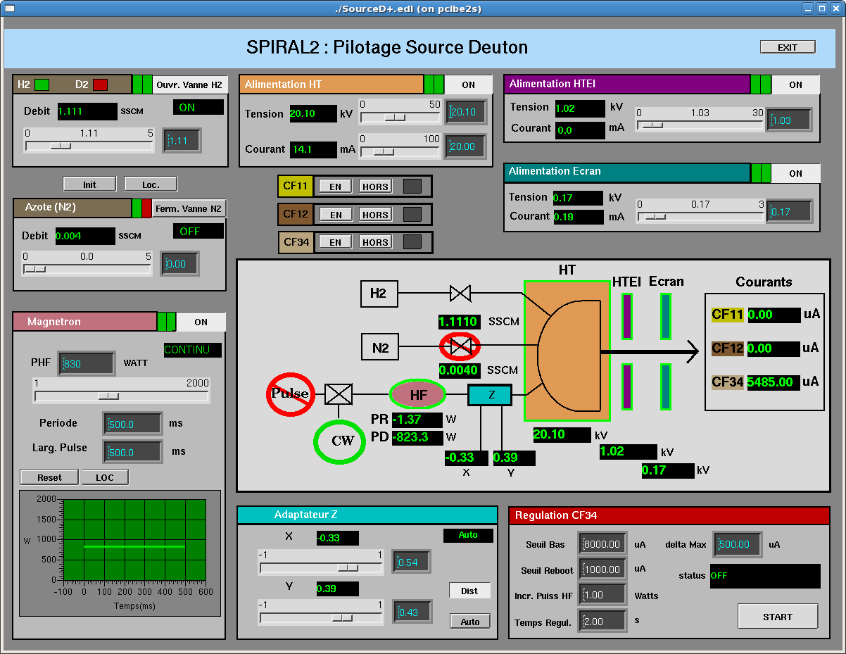
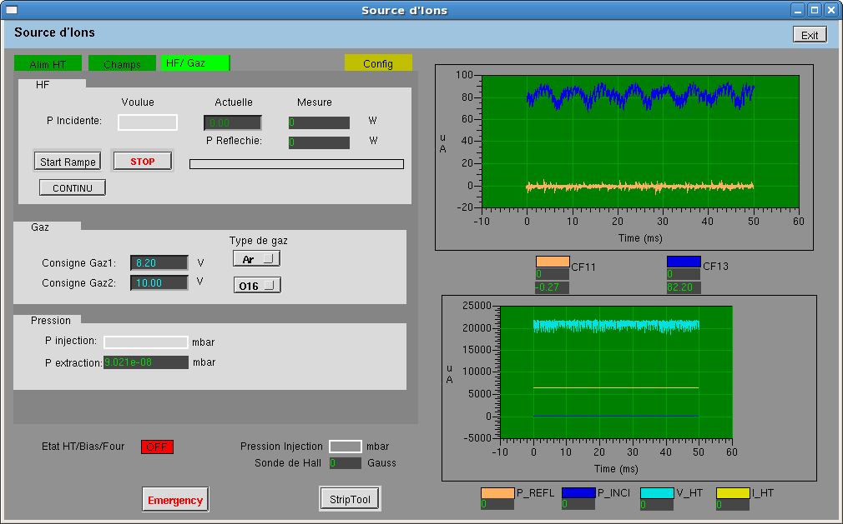
Sources and LEBTs : sources control
Deuterons & LBE2/C :
Used and validated during
production tests @Saclay
Ions & LBE1 :
Different from the @Grenoble control system ⇨ To be tested
Notes:
As Françoise told you, a lot of work was done to get the deuterons source and its associated beam line tested and validated at Saclay, using the control system.
It gave us the opportunity to debug and check the software which is the nearly definitive one.
A work for integrating them within the Spiral2 infrastructure with Ganil requirements is currently under way.
The situation here is quite different as the ions source controls have not been tested as they are now at Grenoble.
First, some part of the system was there in Labview, now it’s full Epics. Also there are new pieces of equipment instead of the LPSC installation ones.

Slide 16
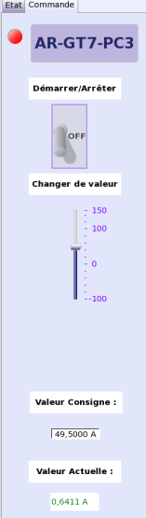
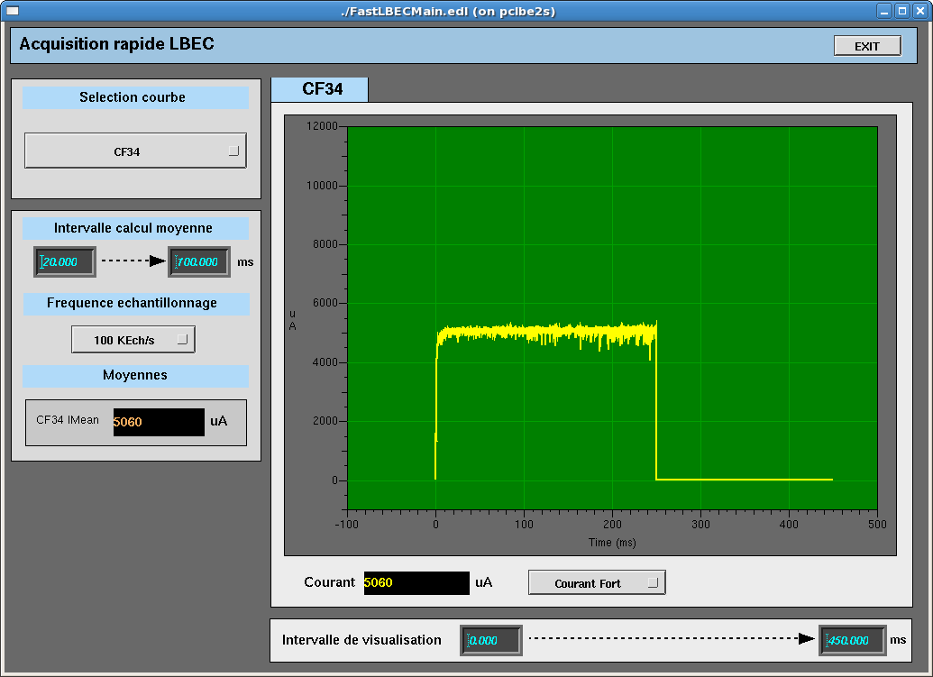
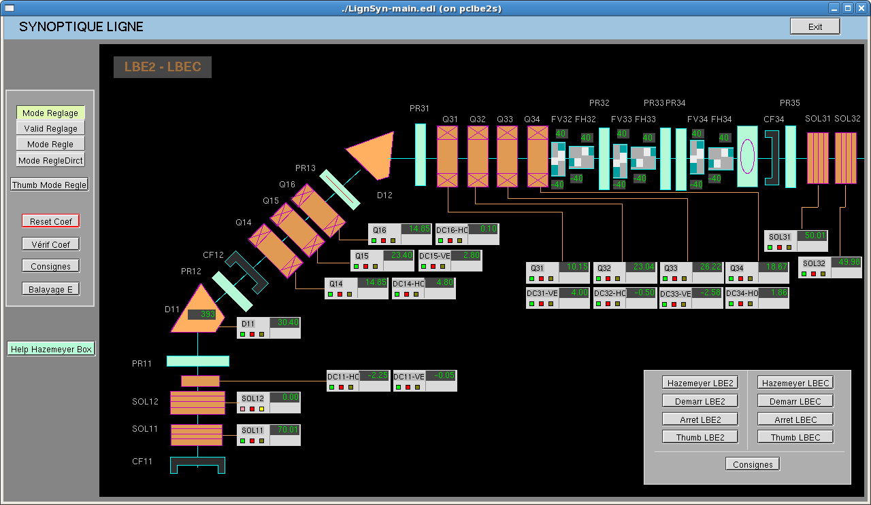
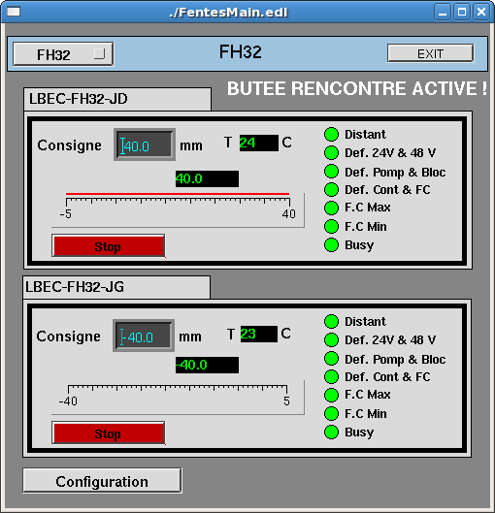
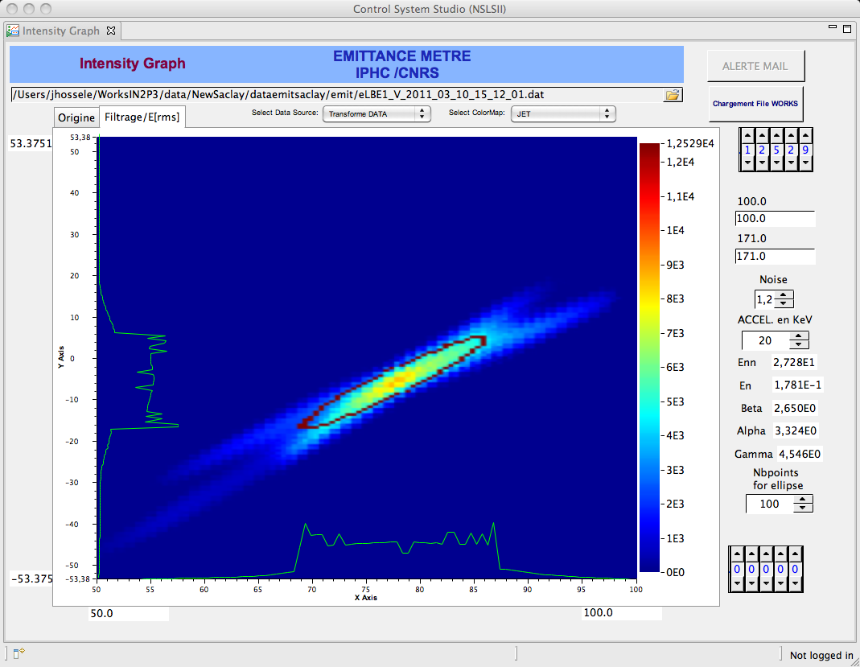
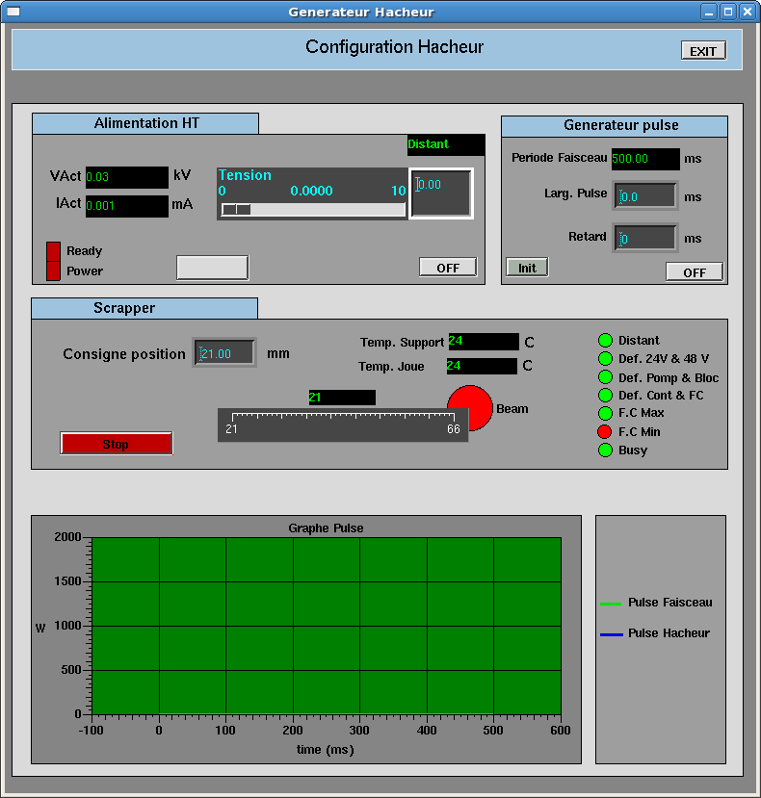
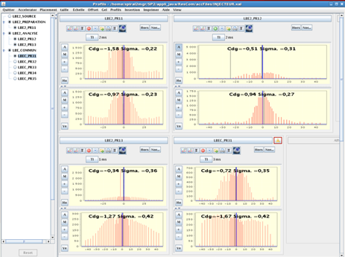
Sources and LEBTs : integration of devices
Power supplies
Faraday Cups & ACCT-DCCT
Slits
Emittancemeters
Slow chopper
Profilers
Notes:
Working on the injector controls lead to integrate many devices.
It was so the case for the power supplies and beam profilers from Ganil.
Irfu on its side provided several interfaces for beam diagnostics, as Faraday Cups and ACCTs-DCCTs, including the fast acquisition VME based system presented by Françoise.
IPHC Strasbourg worked on the emittancemer controls. This is quite a complex environment with a VME crate including specific I/O boards and a PLC is in charge of security issues for the device.

Slide 17
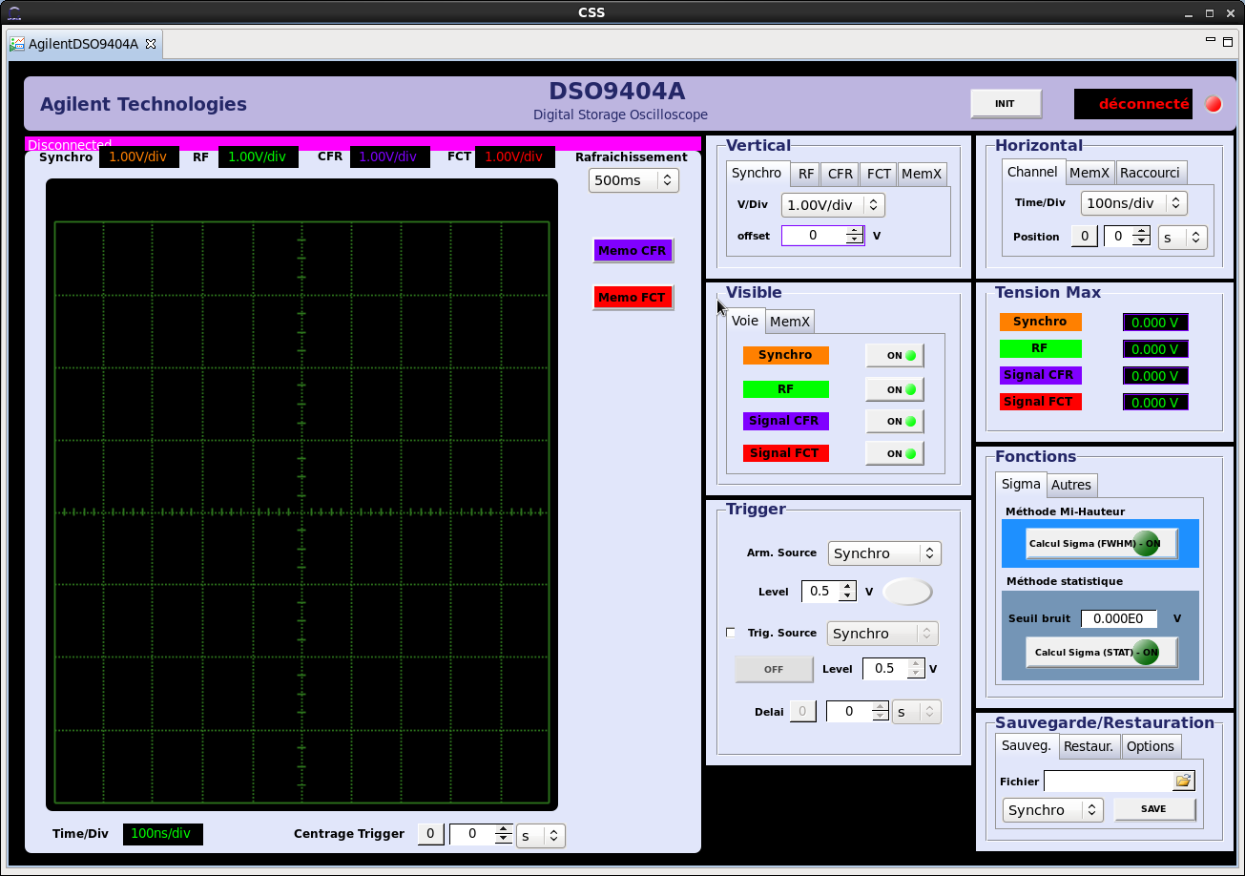
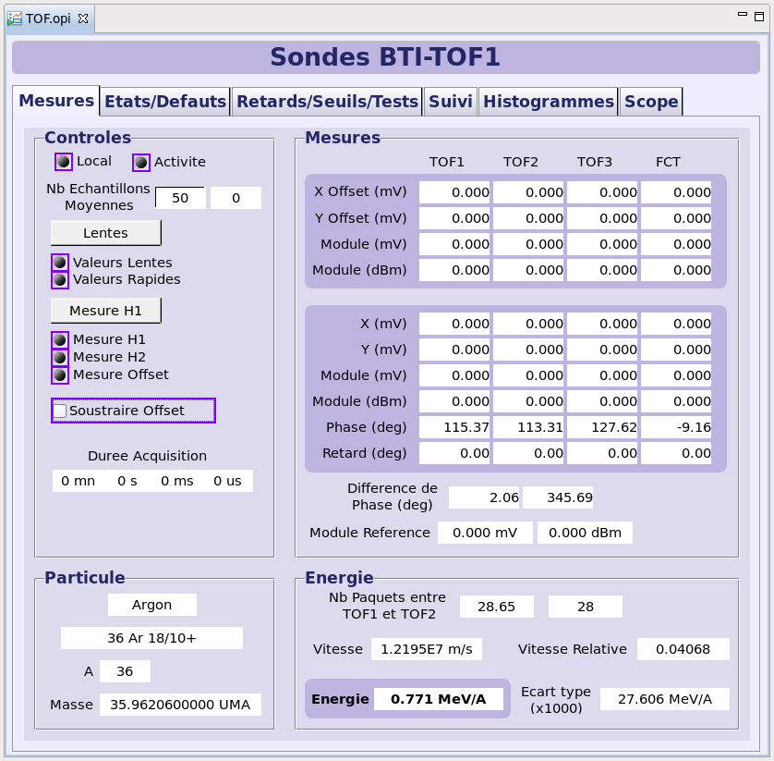
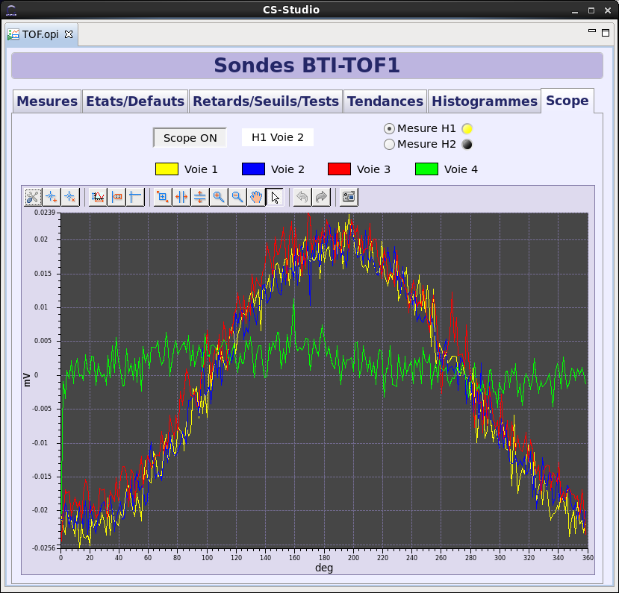
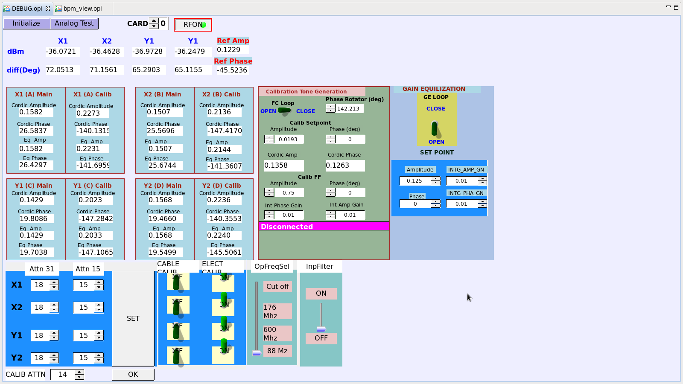



From RFQ to HEBT : Beam diagnostics
Fast Faraday Cup
Stream device
(Agilent Oscilloscope)
Time Of Flight
Modbus-TCP & binary ADAS ICV 196
Beam Position Monitor
Specific VME 64 hardware and software
⇨ In progress
Beam Loss Monitor
Cosylab development for VME Caen 1495
⇨ June 2015
Beam Extension Monitor
NIM Multichannel Canberra Analyzer
⇨ Just starting
Notes:
Linked to the acceleration part of the machine, we also have to interface new beam diagnostics..
First is the Time of Flight one with Modbus/TCP and ADC standard interfaces, so using existing drivers.The first version for BTI use was delivered to the electronics group at Ganil for testing, in respect with the integration rules. A large evoluction has to be planned for using this diagnostic inside the high energy beam line.
An second one is the interface with an Agilent oscilloscope for the Fast Current Transformer and the Fast Faraday Cup.The development has to be validated and checked for integration before its use.
An important diagnostics are the beam losses monitors. Controls interfaces are developped by the Cosylab company technically managed by Ganil. They rely on a commercial VME board integrating an FPGA component. Cosylab is in charge of providing the FPGA programmation as well as the Epics driver, with two levels of functionality. The low level VxWorks driver is written and is waiting for Ganil check. Then specifications for the upper layer software should be given for the upper level to be developped by Cosylab.
Beam Position Monitors interfaces consist of a specific electronic VME board developped by BARC laboratory with a dedicated Epics driver to be written.
The software so delivered is under evaluation.
Last beam diagnostic software to be provided are the Beam Extension Monitors. It’s quite a complex system mixing a PLC, NIM cards including a Multichannel Analyzer board. The work is just starting now, with some exchanges with the provider Canberra to get information for the specific Epics driver to be written.

Slide 18
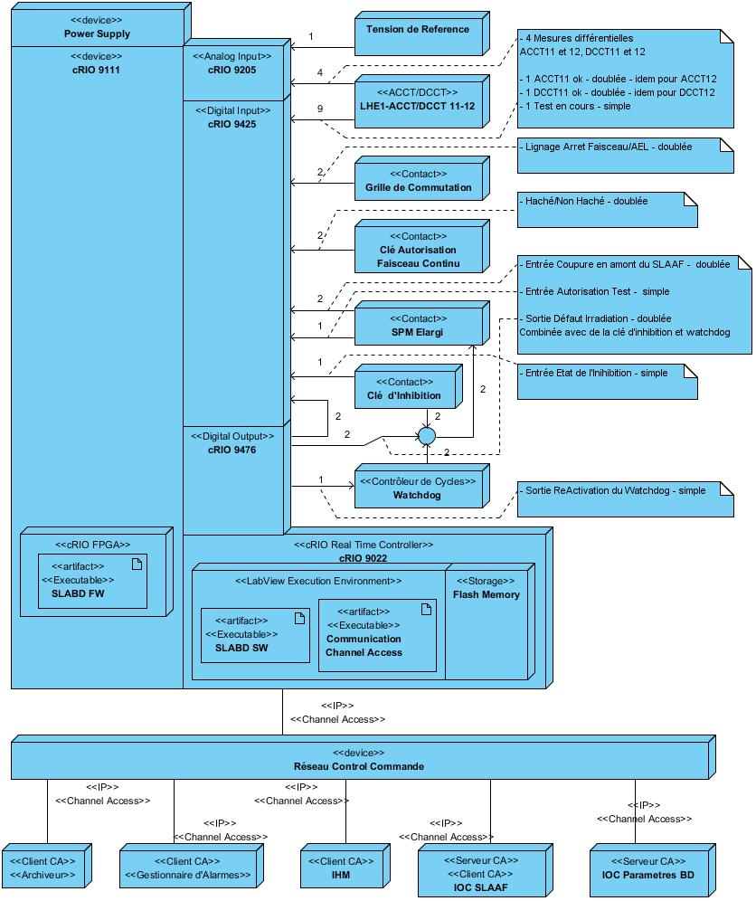

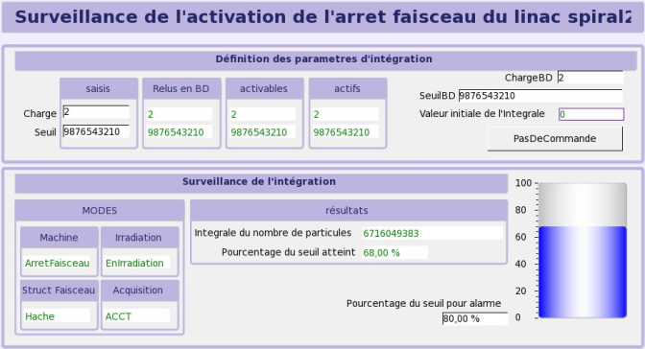
From RFQ to HEBT : beam dump activation monitoring
Implementation
Objective
EPS classified device
FMEA required
I/Os
Labview cRIO device
EPICs IOC
Limitation of the Linac beam dump activation
CSS/BOY GUI
Notes:
A quite particular solution we had to work on is the system to limit the Linac beam stop activation .
The objective is to permanently survey the beam intensity so to limit the power on the device during 24 hours periods.
As the system is a classified EPS device, the design, development and implementation have to respect quality insurance procedures and rules, including a failure mode analysis study performed by an external company.
The controls implementation relies on Labview cRIO device with an embedded FFGA beside the standard controller, with redundant or duplicated I/Os.
Therefore, the system is autonomous for surveying the power and sending beam cuts if required. It has a connection with the control system so the LabView / Epics gateway is used.
So standard Epics tools can be runned, such as the GUI interface for configuration or the archiving system.

Slide 19

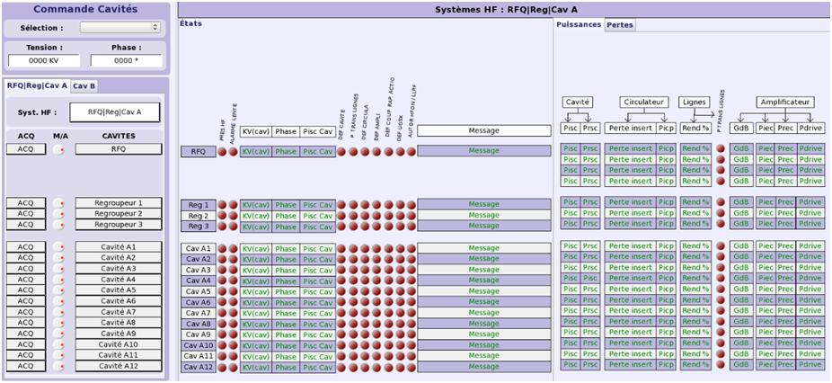
GUIs : CSS/BOY use
CSS/BOY suite adapted for Spiral2 (Ganil)
  Nb : former EDM screens developped at the beginning still there
  Contexts :
    CSSdev : development
    CSSop : operation
  Widget library
Available :
  TOF / FCT-CFR interfaces, Emittance control & display, AES interface
Under development
  BTI GUI, Machine synoptics
To be developped
  Interlocks, Beam pulse control, Beam losses
And many others to come …
RF supervisory controls
(under evaluation)
Notes:
A few words now concerning the CSS use for the project.
The three labs from the collaboration agreed to adopt CSS/BOY suite, having used EDM at the beginning, some of the first applications being still tjhere.
Ganil proposed and develops some adaptations for development and operation as we are going to see in the following slides.
Some of the CSS/BOY applications are available as we saw during the presentation, , others are under development such as interactive synoptics as the one displayed here.
Many others will have still to be produced, some of them are already identified such the interlocks, beam losses, beam pulse controls and so on.
We are aware that many other needs will appear and we expect that using CSS/BOY wille ease to answer quite quiclky most of them..

Slide 20
CSSop
GUIs : CSSop
Operator control environment : CSSop
  Implementation :
    Perspectives limited to CSS runtime and data-browser
    One unique workspace NFS mounted for all stations
    (Eclipse lock suppressed)
  For operation :
    No editing capability for no hazardous modifications
    Light view : unused menus suppressed
    One central and unique launcher for all applications :
    CSS, Java/XAL, EDM (+Ganil/Ada ones).
Notes:
So let me go into some details for this point now.
The main goal for us was to provide an Operator control environment, this is the so-called CSSop distribution.
It is implemented with limited perspectives, that’s to say the CSS runtime and data brower ones.
Then, the features for operational use are restricted so that there are no any editing capability.
Also, unused menus are removed and the entry point is one unique central launcher for all applications : CSS, Java/Xal, EDM or still former Ada ones.

Slide 21
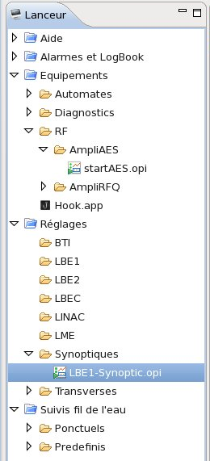
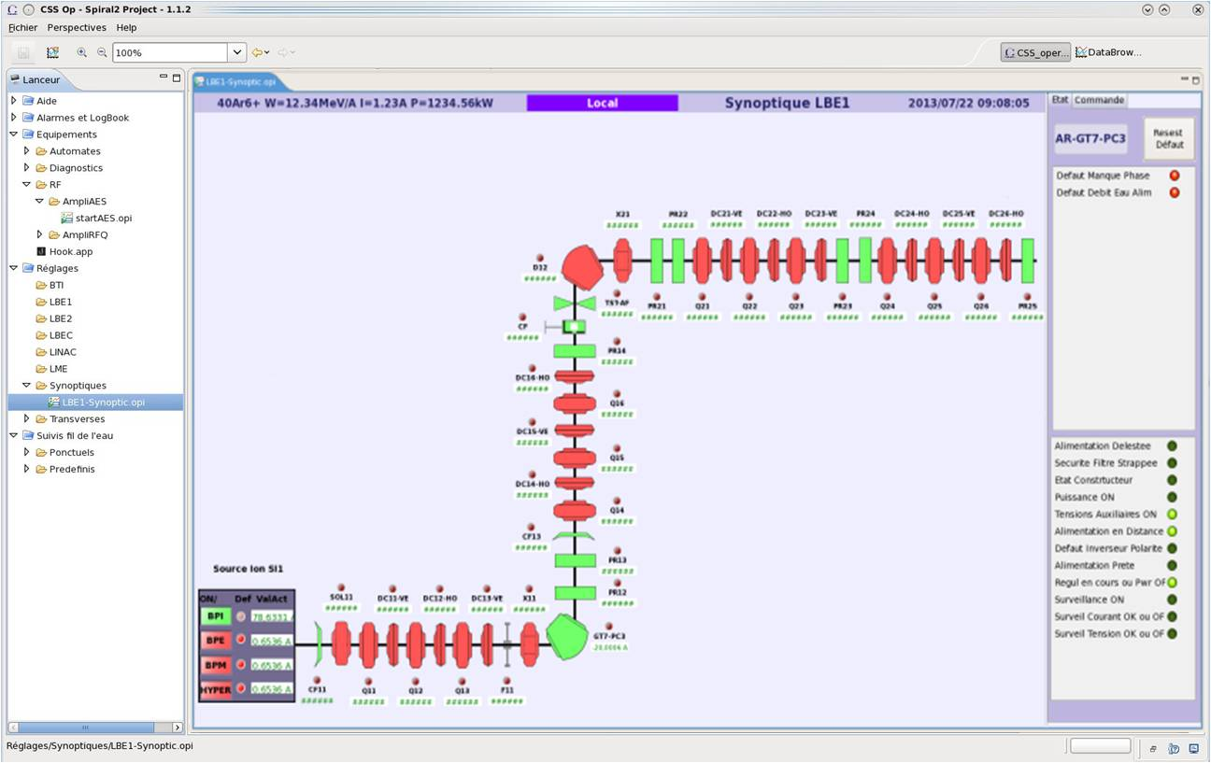
CSSop :Synoptique view
GUIs : CSSop synoptic
Alarms (java)
Beam characteristics
e-logbook (j5)
Equipment (CSS)
Tuning (java)
Data Browser (CSS)
Equipment
Synoptic
Launcher
Notes:
So within the CSSop synoptic framework, we find first the launcher.
From here, the operator can call either the alarms display, the e-logbook environment, CSS opi for synoptics or equipment, Java/Xal applications or data browser CSS clients.
The CSSop also predefines some opis :
the main panel is an opi representation for the synoptic itself, having an opi container to display the beam characteristics.
The right area on the right is reserved for individual equipment interactions, such as commands or status and default representations.
Concerning the machine synoptic display, we defined a widget library for the main components such as quadrupoles, dipoles,slits and for example Faraday cups.

Slide 22
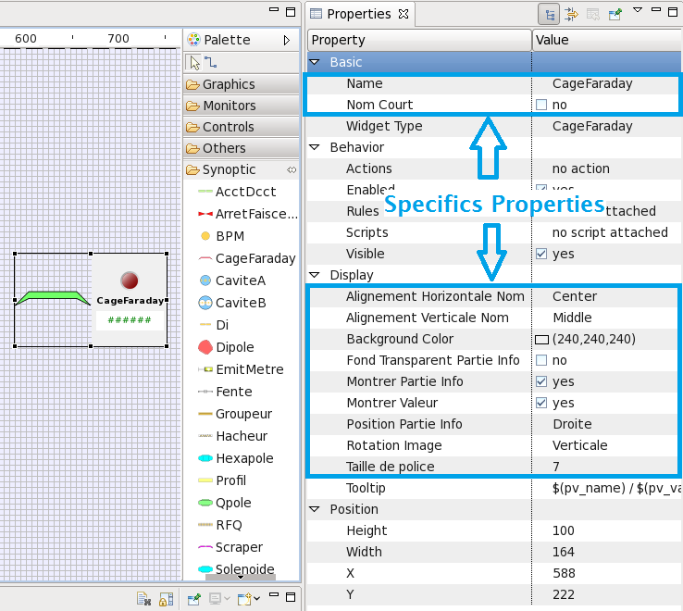



CSSop :Synoptique view
GUIs : CSS widget library
Optional displays
Alignment
Font size
Rotation
Notes:
So this is the Faraday cup widget, with its graphical representation showing the device and a LED indicator.
Properties are defined so people can represent it with optional displays.
Alignment can be chosen and the graphical representation itself can be rotated.
Lastly, font size can be adjusted.

Slide 23
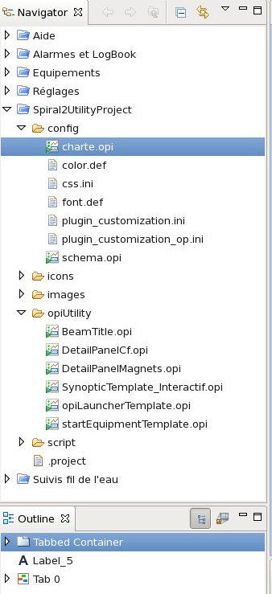
CSSdev
GUIs : CSSdev
Development environment : CSSdev
  SPIRAL2 accelerator widget library
  SPIRAL2 OPI templates automatically
  added in user’s workspace :
    Beam characteristics header
    Launcher
    Pydev added
    SVN access added …
  Common icons and pictures
  Graphical common usage template
CSSdev & CSSop distribs’ link :
  https://u.ganil-spiral2.eu/csssp2/
Notes:
Prior to the operation use, for developpers, we provide the CSSdev environment for development providing the specific accelerator widget library and adding features within the user’s workspace .
The CSSdev and CSSop distributions are shared by the labs through the link pointed here.

Slide 24
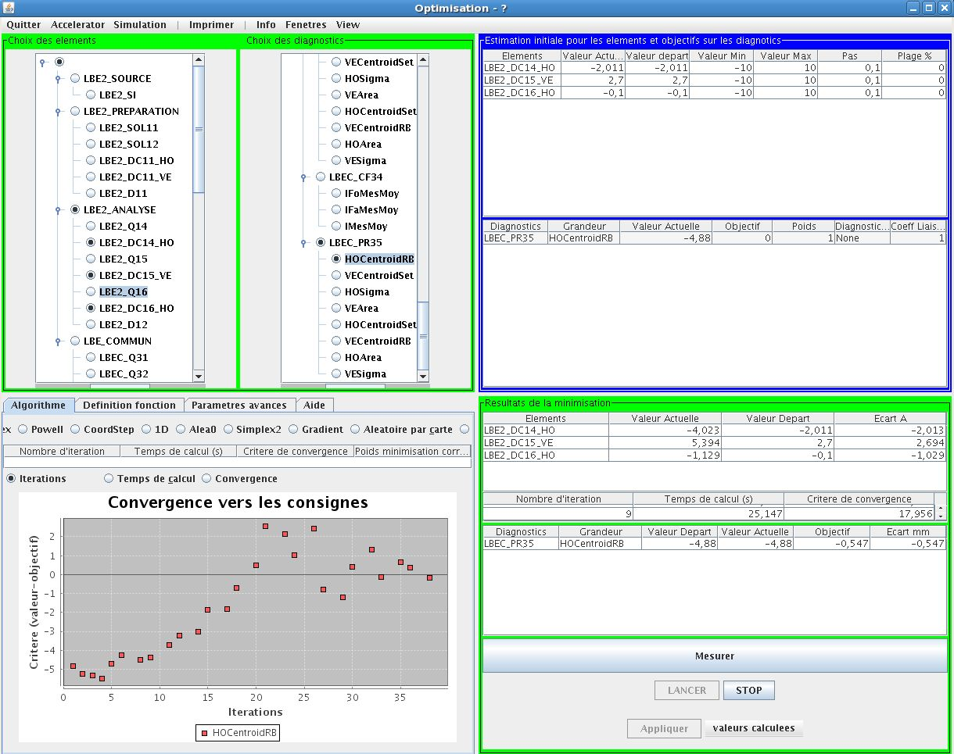
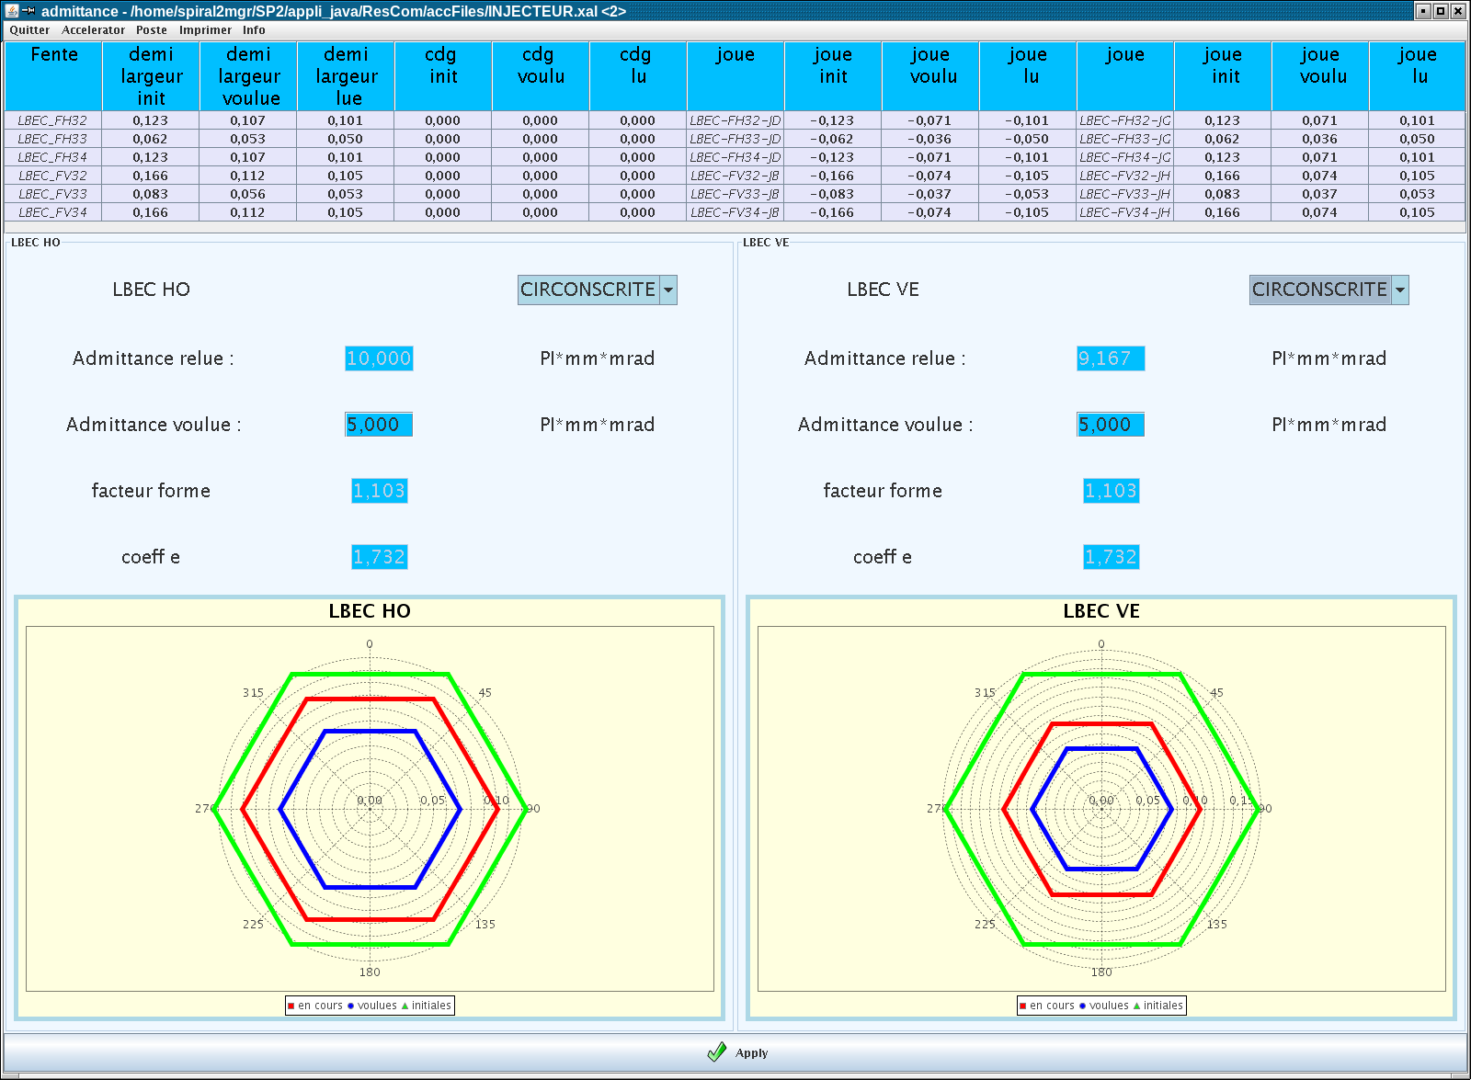


GUIs : high level applications
Environment
  Java programmation
  Derived from
  XAL framework (SNS)
Available
  Parameter management
  Optimization
  Emittance limitation
  Beam analysis
  Hook
  Beam profilers display
Under development
  Power raise
To be developped
  Cavity tuning
  MPS
Emittance limitation
(tested @Saclay)
Optimization
(tested @Saclay)
Cavity tuning
(simulation mode)
Power raise
(graphical design)
Notes:
The other GUI environment concerns high level applications. They are written in Java within a Spiral2 framework derived from the SNS Xal one.
Some of them are available, having been partially tested at Saclay during the beam production tests, it was the case typically for the optimization emiitance limitation and beam profilers display ones.
Others are still under development or have to be developped, such as the cavity tuning or the MPS related applications.

Slide 25

Integration : work flow
work flow diagram
Evolution type ?
IOC
Module
Equipment conf.
Integration mechanism
  Coherency check between
    Software deliveries (through SVN)
    Conventions & rules
  genIOC environment
Control system evolutions
  Identified items :
    topSp2 repositories
      Modules
      Equipment
      Alarms
    CSS GUIs
    Java applications
  Operation & maintenance modes
  Procedures
  Software tools & utilities
Switch to maintenance mode
IOC or module creation
/modification
Equipment configuration
Functionnal tests
Switch to operation mode
Notes:
As we are now entering the final phase of the project, we have to prepare the sofware integration.
First, we have to check the coherency between the sofware deliveries and the rules or codifications as defined during the development phase.
Also so we have to consider how to integrate previous software within the genIOC environment which ariived quite late during the development process.
We are also trying to organize the future daily work flow for evolutions of the control system. It can concern the different objects constituting the control system software such as the topSp2 repositories, CSS GUIs and Java applications.
To achieve that in a safe way, the control system would be able to be switched to maintenance mode and then back to the operation mode, with some automatic SVN archiving of the previous situation.
We are currently working on defining the procedures together with some script utilities for common use.

Slide 26



Conclusion : and now ?
Sources + LEBTx
12/2014
RFQ + MEBT
05/2015
Linac + HEBT
09/2015
Control system
  Software :
    Infrastructure : ~ready for use
    Integration of external developments on Ganil site : in progress
  Testing & commissioning
    Sources & LEBTs :
      Prior to software : installation, cabling and wiring tests
      Control system tests possible when equipment declared available
    From RFQ to HEBT :
    ~ expect to provide basic functionalities
  Knowledge transfer : ?
Spiral2 project
Ganil Accelerator Division
Operation
Technical groups
 Control group
Notes:
This is now the concluding slide.
First, here are the main milestones soncerning the project : starting the facility with the sources and LEBTs should start by the end of this year, then the RFQ commissiong and the beam qualification at its output is planned in May while the whole commissionning is expected in September next year.
For the control system, the infrastructure is nearly ready for use, with some configuration to be done according to project needs.
Integration of external developments is in progress, being still a time consuming task.
For the injector, prior to software tests, cabling and wiring have to be checked. Then control systems tests will be possible when equipment will be declared available.
We estimate around 2 weeks to get the control system ready r for the deuterons source and the LEBT2 line. It will be longer for the ions source and the LEBT1 line never used previously.
For the acceleration process, we expext to be on time for the main basic functionnalities.
The question of knowledge transfer from the other labs is still to be solved, according to human ressources.

Slide 27




Thanks for your attention !
Denis J.F., Gougnaud F., Lussignol Y. (Gournay J.F.)
Graehling P., Hosselet J., Maazouzi C.
Deroy J.C, Gillette P., Haquin C., Lécorché E.,
Lemaître E., Normand G., Patard C.H., Philippe L.,
Rozé J.F., Touchard D.
(Duneau P., Lermine P., Loyant J.M.)
Notes:
So this is the end, I would like yet to thank all the contributors listed here,
Lastly, I take the opportunity of this slide to show you some prototype of the main synoptic inside the PCD room.
Thank you for your attention !

